Slide 1
Thermoelectric data teMatDb: ultrahigh quality material transport data
Byungki Ryu,*
J Chung, SJ Park, JH Son, SJ Park, YH Ihm, SD Park
Korea Electrotechnology Research Institute, Korea

Slide 2
Goal and actions
High-quality data for transport analysis
Can be used for machine learning
In this work,
Error analysis
Error case categorization
Filter development
Q-Q analysis
Distribution and comparison
Center of mass and boundary for TEPs
Performance boundaries (singleleg limit)
Open source
Github repository for data and code
TE Simulator app using (python, pykeri, streamlit)

Slide 3
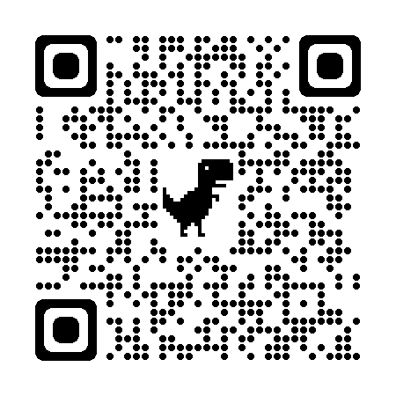
* Ultrahigh quality TE mat. DB for data science and machine learning
QR code for (teMatDb v1.1.1b)
Feature
TE property data
Metadata: composition, process
Error analysis
Error filter
Error analysis
Data size
353 before filtering
268 high-Q dataset

Slide 4
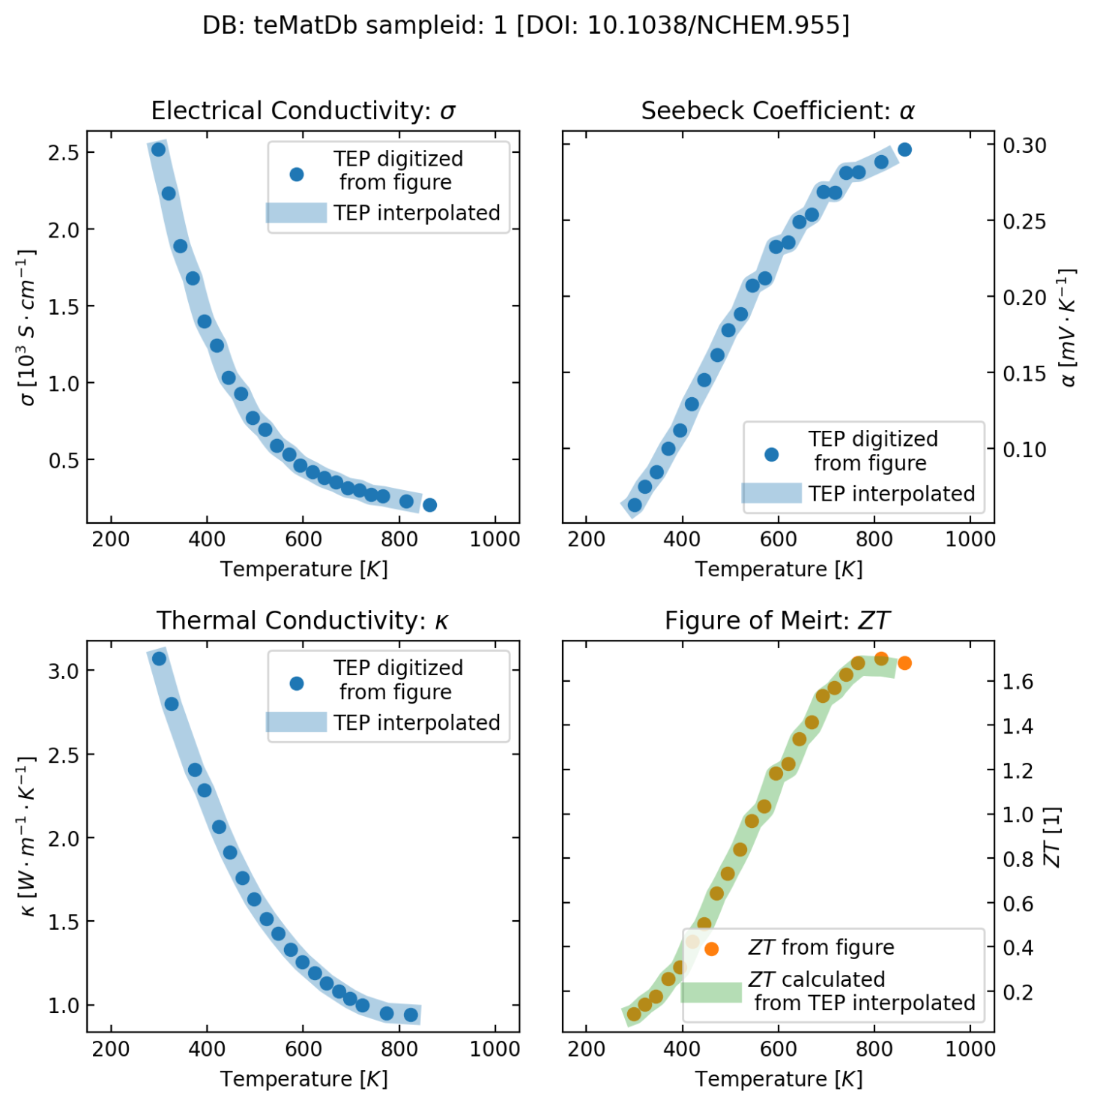
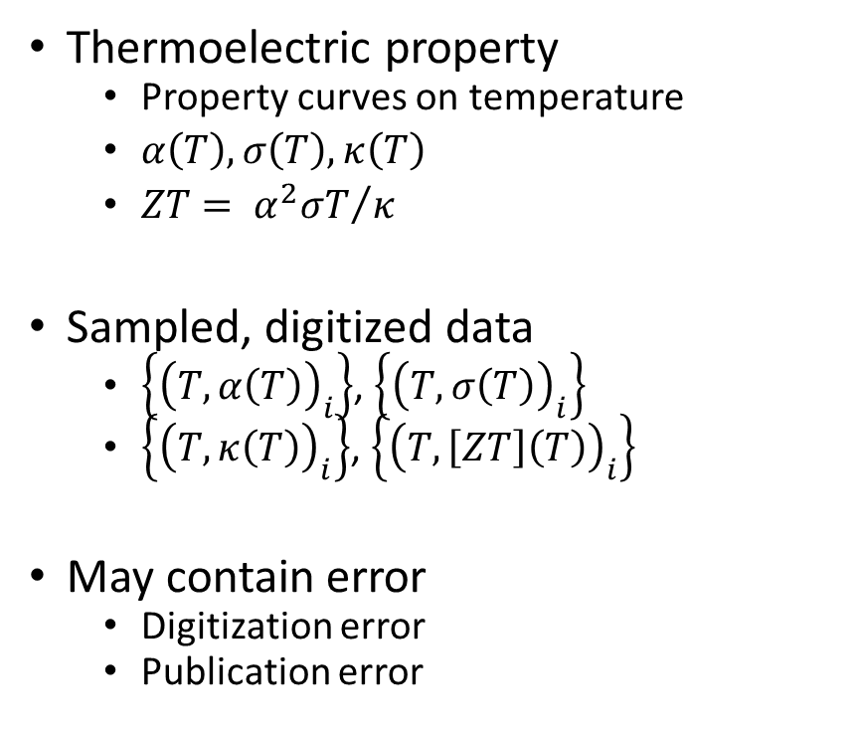
Thermoelectric material data digitization
Thermoelectric property
Property curves on temperature
$α\left(T\right), σ\left(T\right), κ\left(T\right)$
$ZT= {α^{2}σT}/κ$
Sampled, digitized data
$\left\{{\left(T,α\left(T\right)\right)}_{i}\right\}$, $\left\{{\left(T,σ\left(T\right)\right)}_{i}\right\}$
$\left\{{\left(T,κ\left(T\right)\right)}_{i}\right\}$, $\left\{{\left(T,\left[ZT\right]\left(T\right)\right)}_{i}\right\}$
May contain error
Digitization error
Publication error

Slide 5
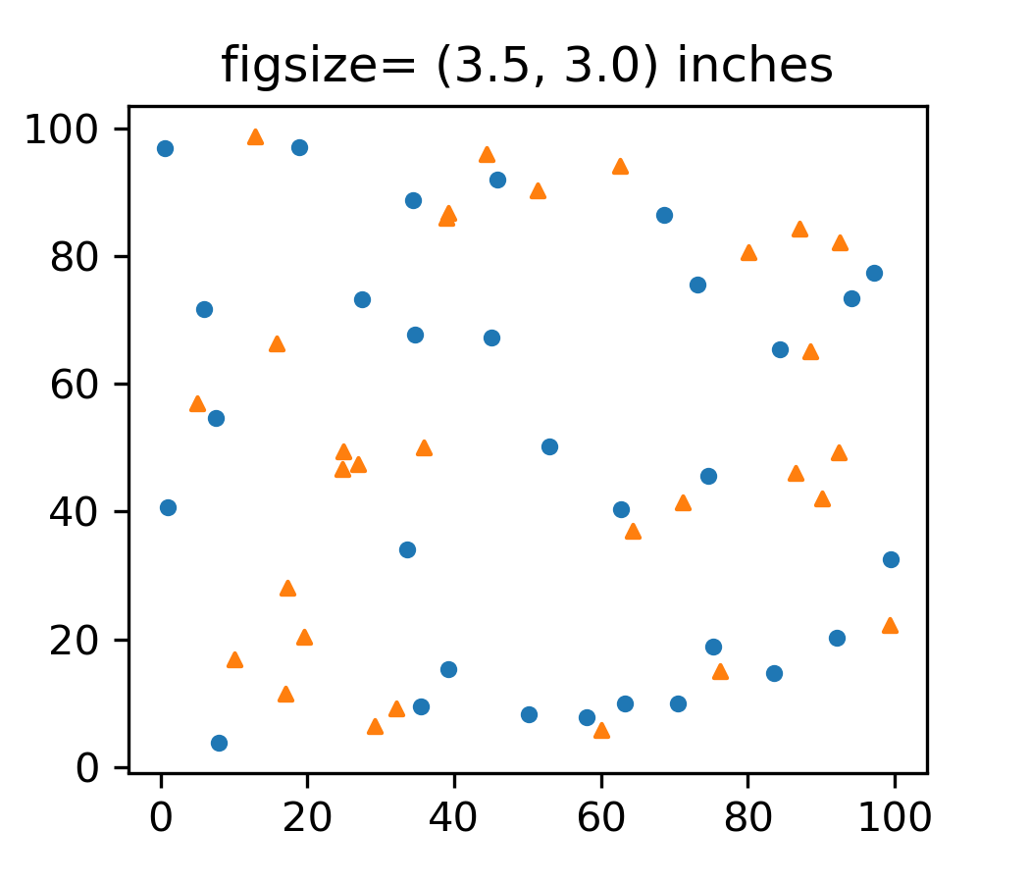
Human-labor digitization uncertainty
Data generation, digitization
(x, y)
(x’, y’)
Calculate deviation
(dx=x’-x, dy=y’-y)
Std error is small enough:
For 3.5 inch wide, Lx=Ly=100
72-300 dpi figures: less important
Dpi > 72 would be necessary
1/ (3inch x 72 dpi) = ~1/200 = 0.5%
Circle, triangle: less important
dx/Lx, dy/Ly< ~0.5%
Uncertainty estimation with assumption (df/f is small)
d(ZT) = (ZT) x sqrt(7) df/f = 3.1 x 3.65 x 0.005 = 0.04
95% (k=2) ➔ d(ZT)=~0.08 < 0.1
df/f can be large enough
Normal single-column figure, < 3.5 inch

Slide 6
Impact of data filter
Starrydata, 20211124
teMatDb, v1.1.1b
Original filter
11846
After filter
(filter1) 9373
(filter2) 7353
Previous filter (iScience 2021)
~30 filters,
ZT-ZT filter: 70% - 130%
sampleids_in_fig3a (teps) = 13338
sampleids_in_fig3b (etas) = 12645
sampleids_in_df_tep_extended= 11846
No filter
353
After filter
(filter1) 268
(filter2) 236
Criteria
d(avgZT) > 0.1
d(peakZT) > 0.1
Max( abs(d(ZT) ) > 0.1
ZT err := L2(d(ZT))=stdev.s > 0.1
Max(ZT err)/(peakZT) > 0.2
Max(ZT err)/(avgZT) > 0.2

Slide 7
DB stats comparison
Level | Starrydata2 (20211124) |  | teMatDb
total | 16420 | 100% | 353 | 100%
physics filter | 13338 | 81%
TEP-ZT complete set | 11846 | 72% | 353 | 100%
ZT filter, level1 | 9373 | 57% | 268 | 76%
ZT filter, level2 | 7353 | 45% | 236 | 67%
Filter, level1
Filter, level2
0.1
0.1
0.1
0.1
0.2
0.2
0.1
0.1
0.1
0.1
0.1
0.1

Slide 8
Filtered teMatDb (1.1.1b)

Slide 9
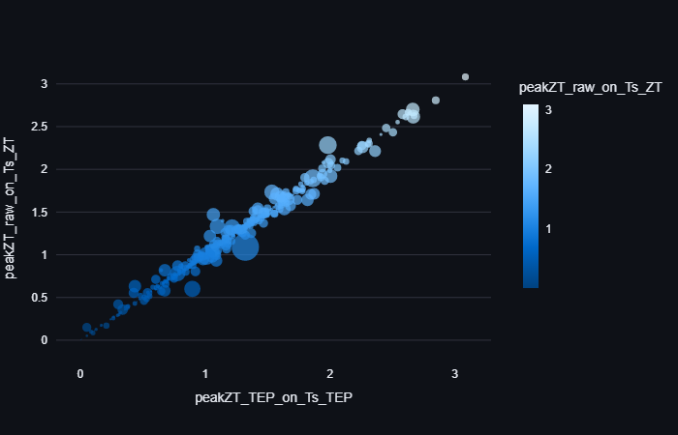
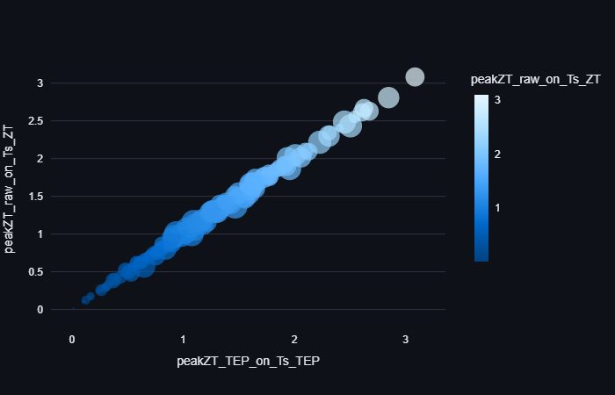
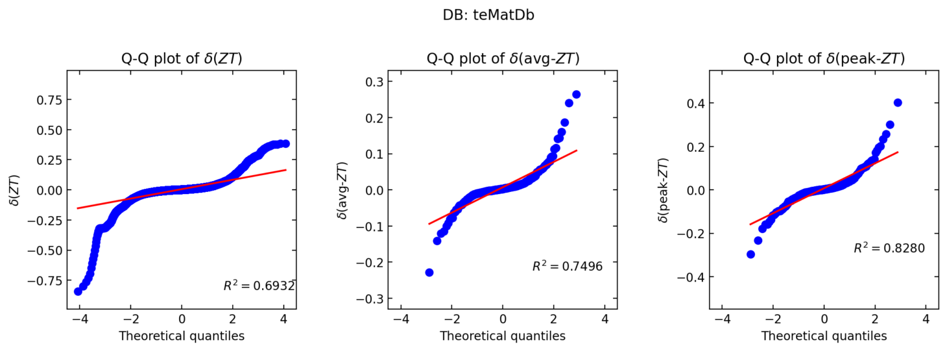
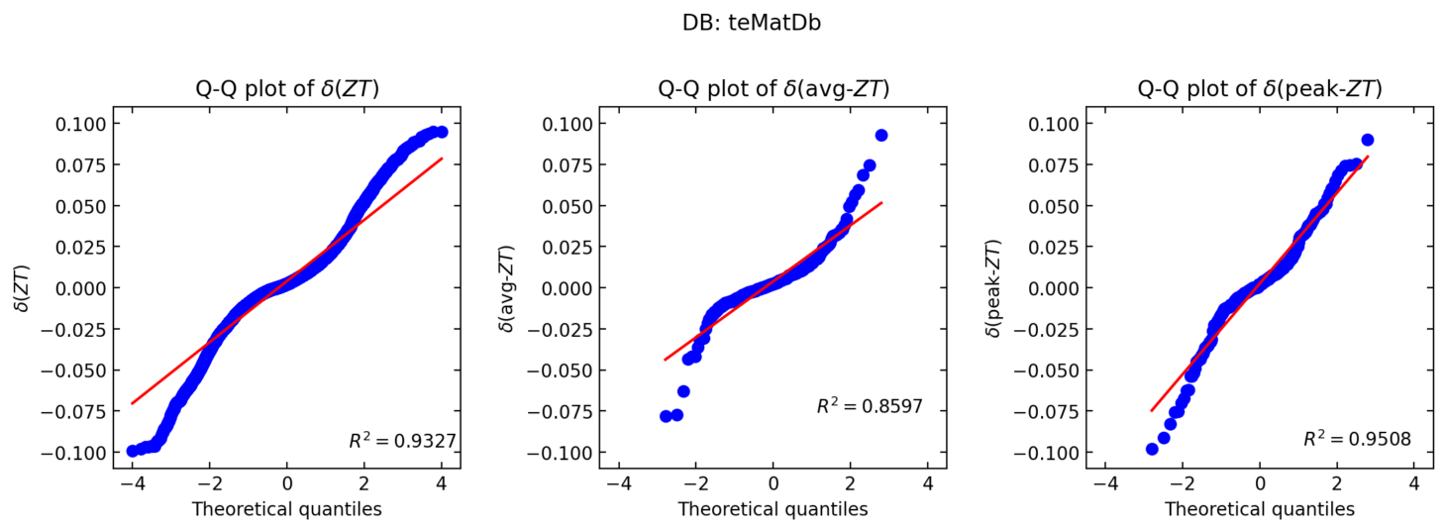
Before filtering: 353
After filtering: 268
0.1
0.1
0.1
0.1
0.2
0.2

Slide 10
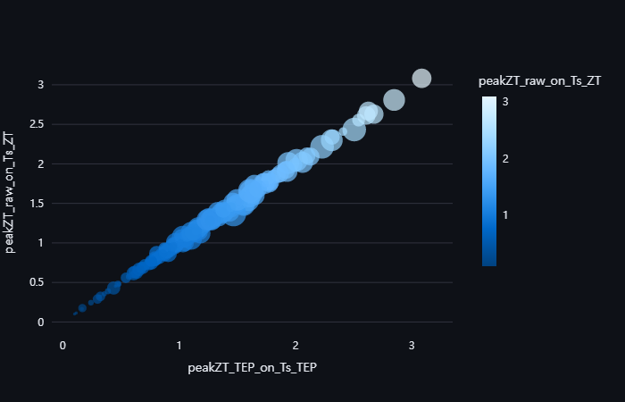
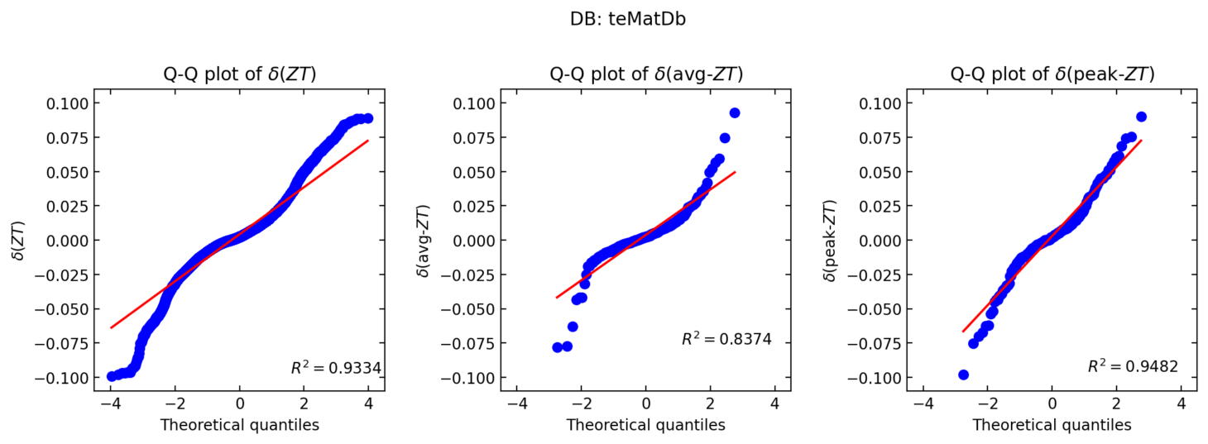
Before filtering: 353
After filtering: 236
0.1
0.1
0.1
0.1
0.1
0.1

Slide 11
Filtered Starrydata2 (20211124)

Slide 12
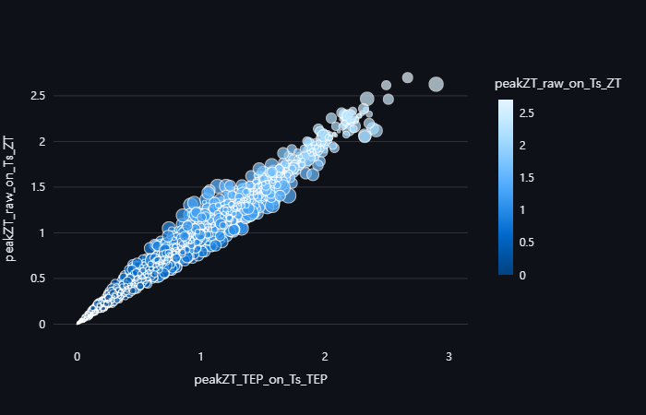
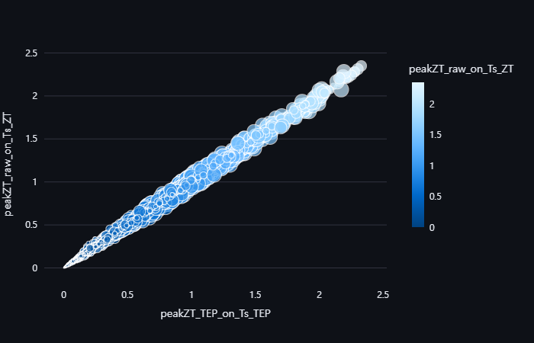
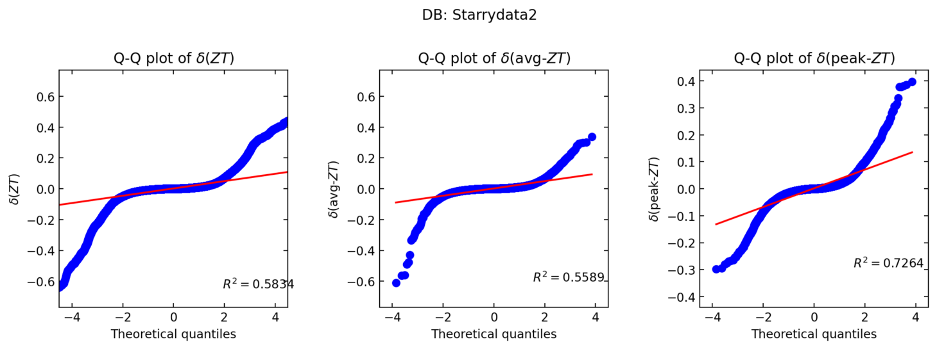
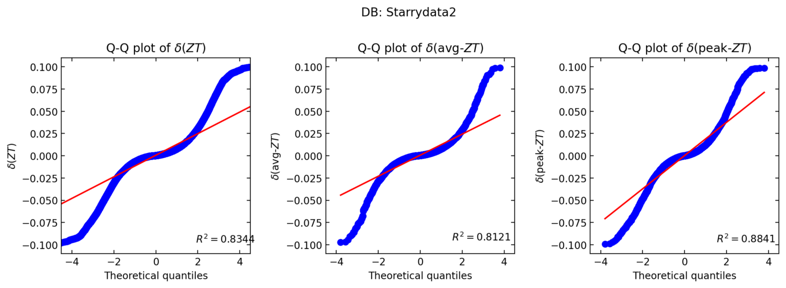
Original filtering: 11846 sampleids
After filtering: 9373 sampleids
0.1
0.1
0.1
0.1
0.2
0.2

Slide 13
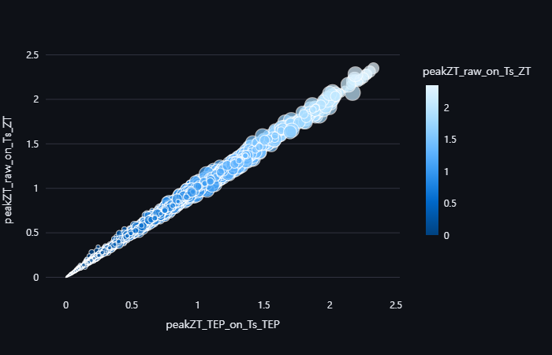
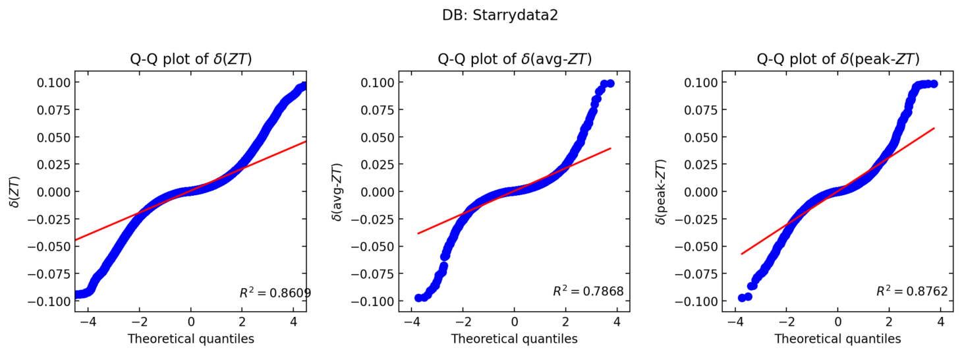
Original filtering: 11846 sampleids
After filtering: 7353 sampleids
0.1
0.1
0.1
0.1
0.1
0.1

Slide 14
Data distribution

Slide 15
Performance and TEP distribution
ZT
Efficiency
Lorenz

Slide 16
Error case (summary)

Slide 17
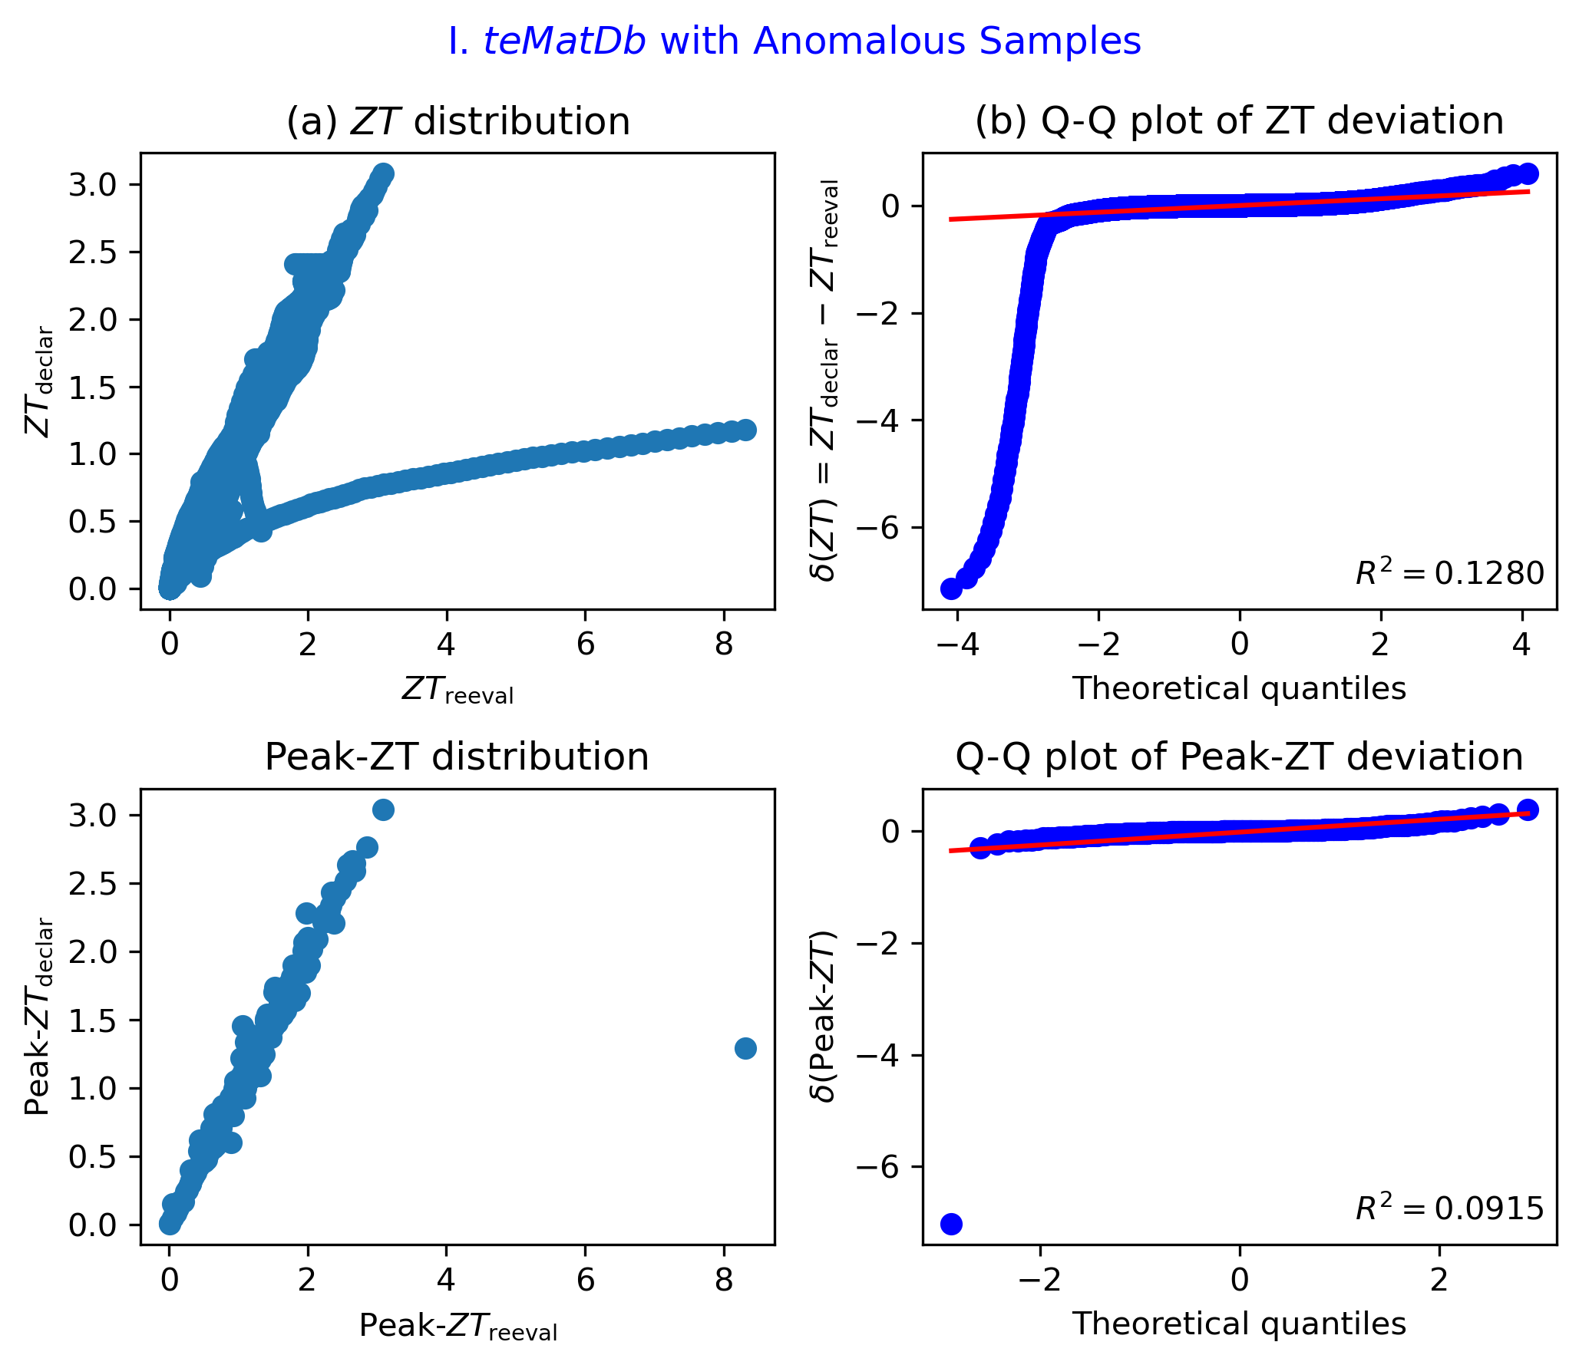
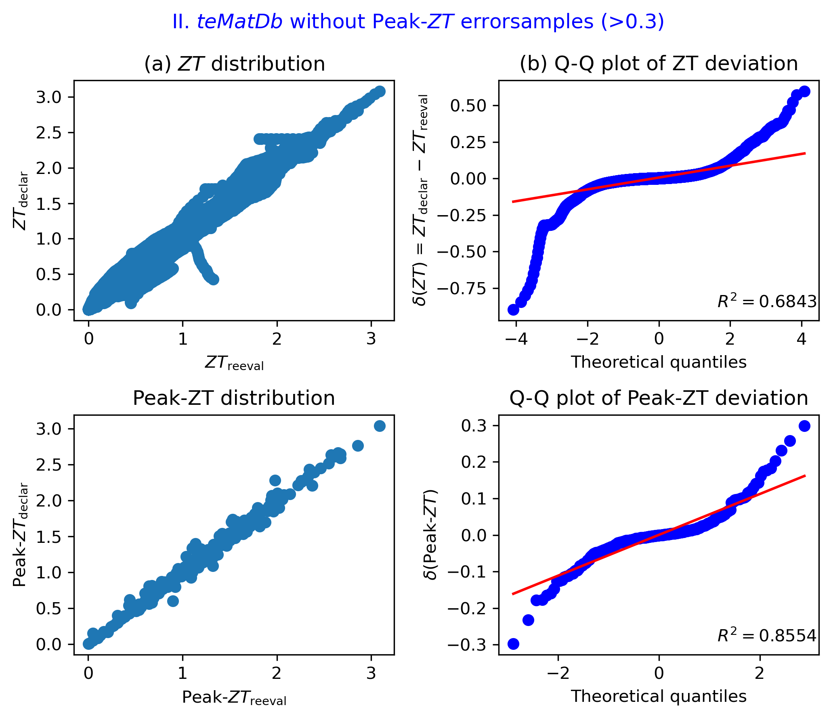
Peak ZT error
1
1
1
1
1
1
1
1
1: sampleid = 235, k_{tot} != k_{latt}

Slide 18
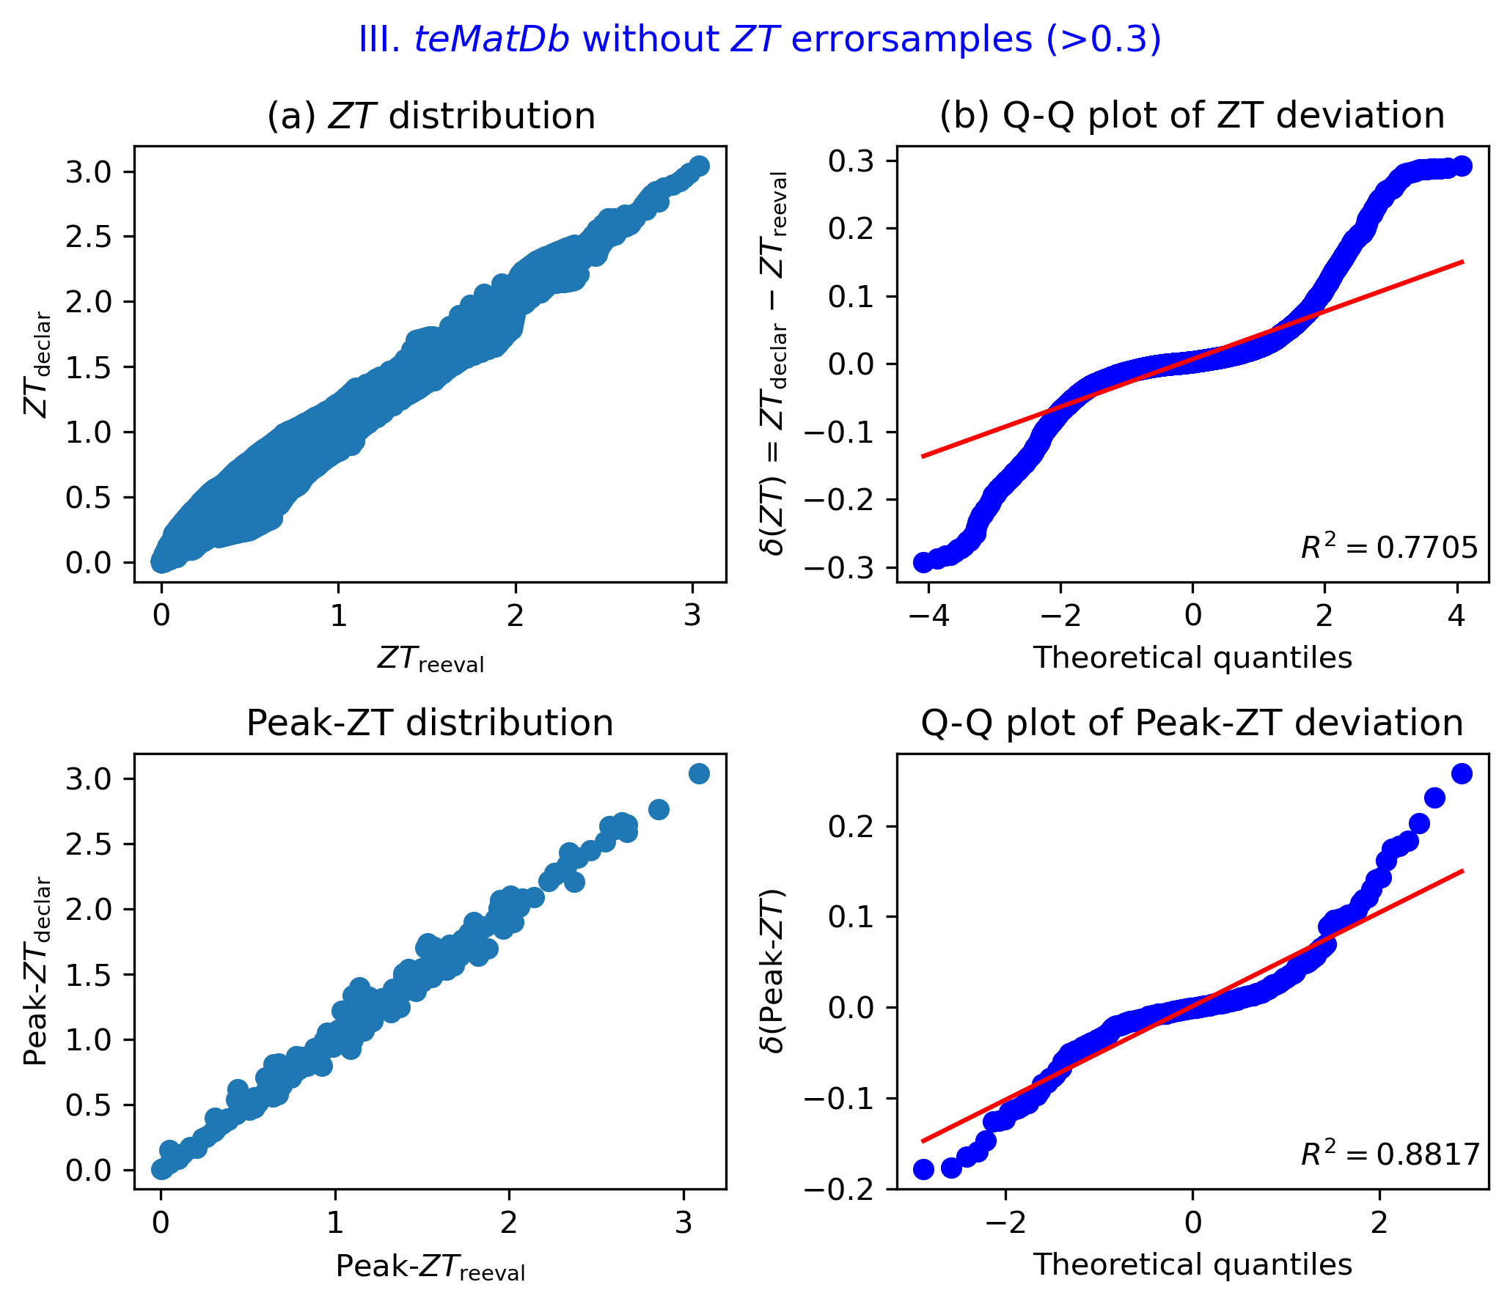
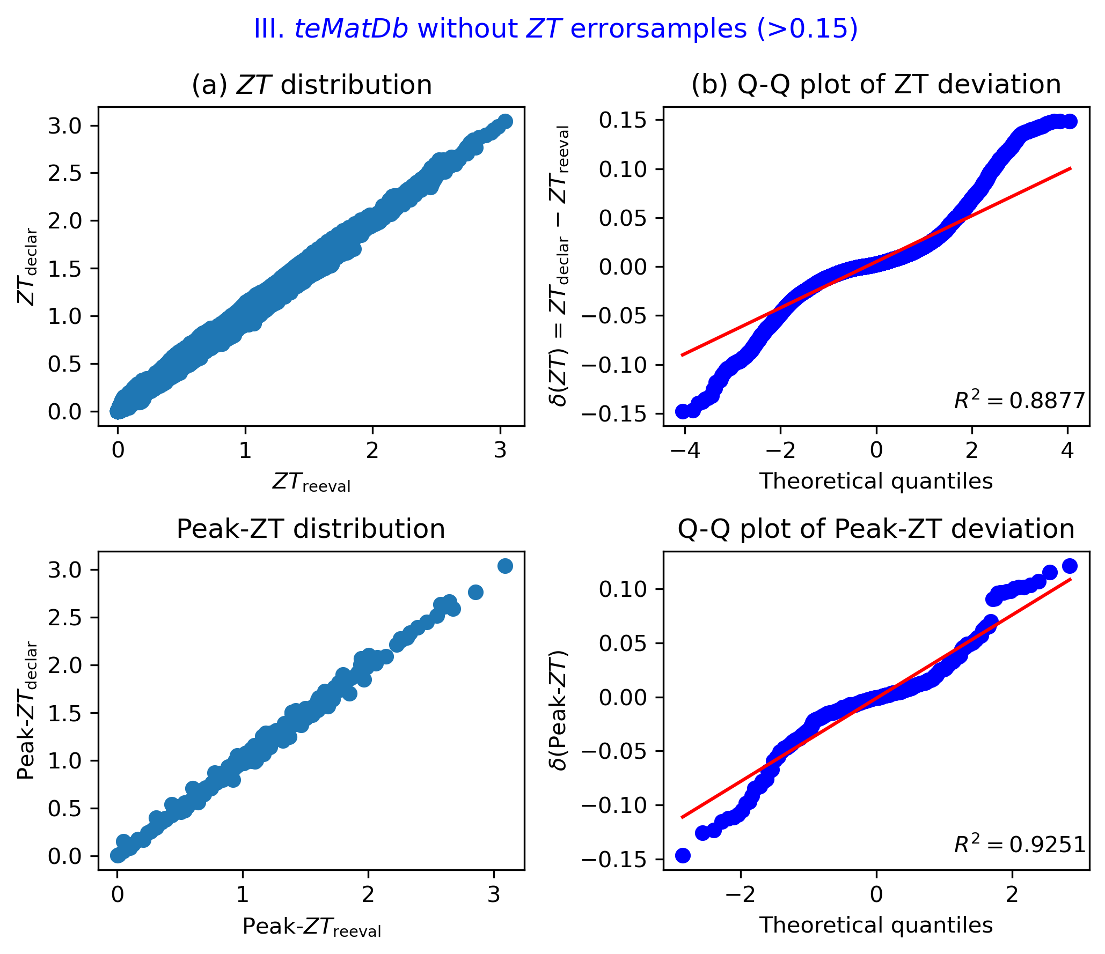
ZT curve error (TEP smallT)

Slide 19

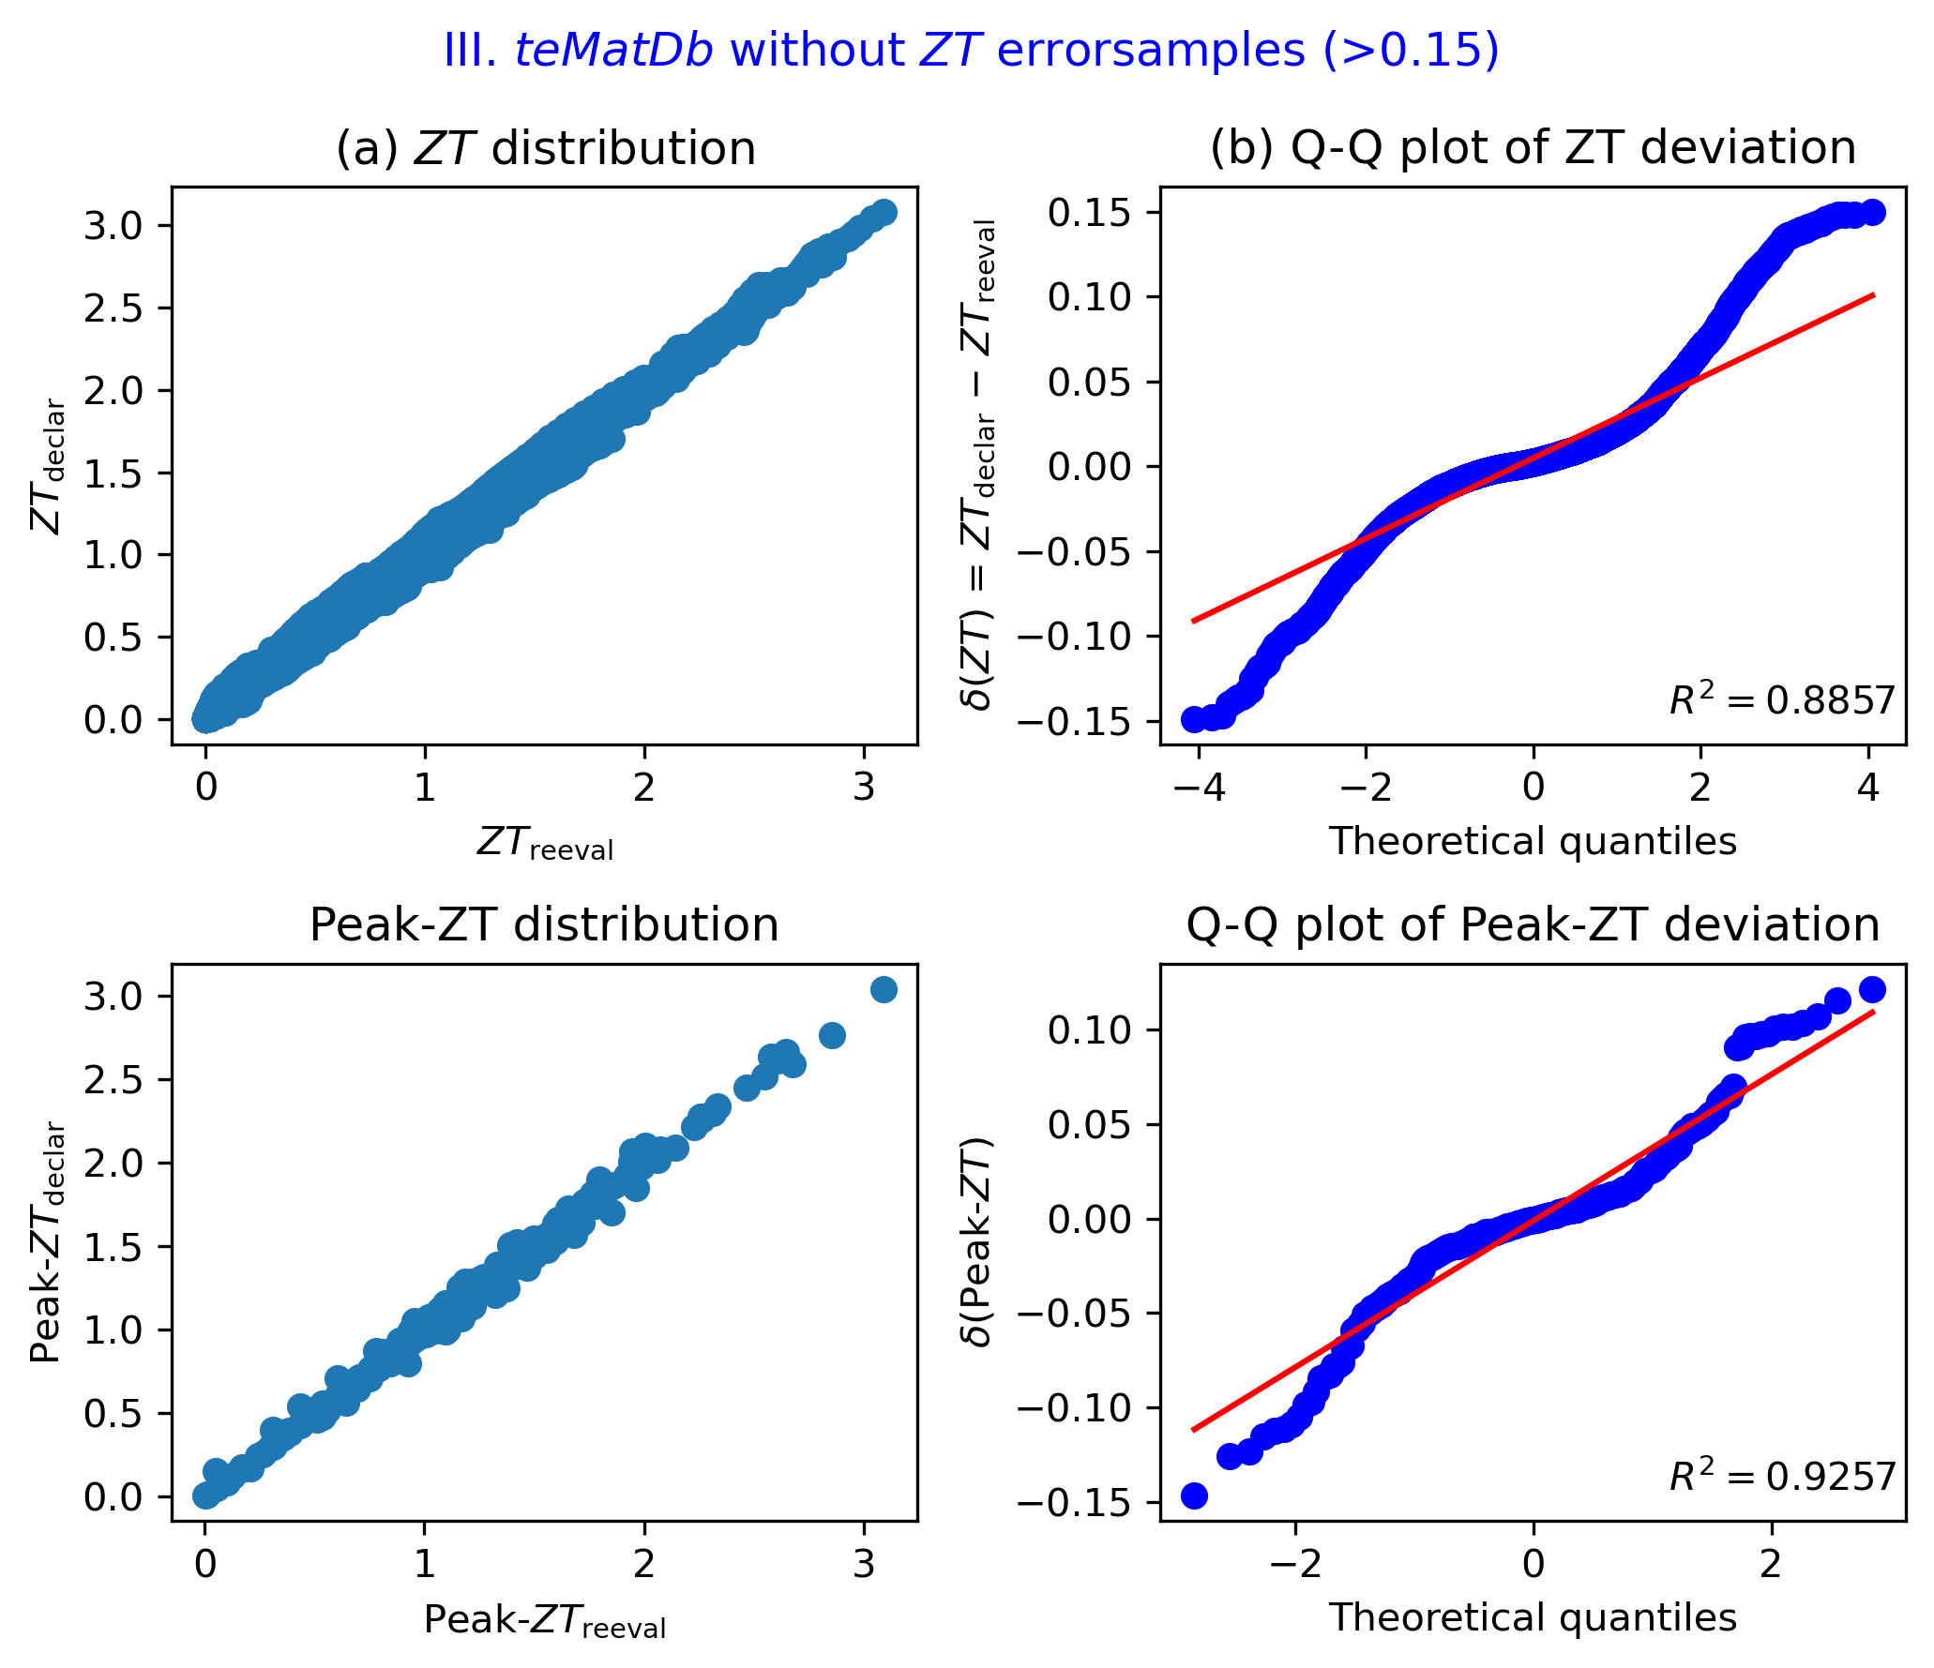
ZT curve error (TEP autoTcTh)

Slide 20
Sample stats (autoTcTh)
teMatDb v1.0
355 valid samples
ZT error removing (>0.30)
353 (peak ZT error cases removing)
345 (ZT curve error cases removing)
ZT error removing (>0.15)
339 (peak ZT error cases removing)
314 (ZT curve error cases removing)
314 high-Q samples
Errorsamples
ZT error removing (>0.30)
[140 156 181 193 235 238 300 415 420]
+[113 235]
ZT error removing (>0.15)
[ 1 2 5 26 27 28 79 81 92 95 98 110 113 124 125 129 139 140 151 152 156 165 181 193 210 220 226 235 238 245 254 285 293 300 355 381 409 415 420]
+[ 1 2 26 79 81 84 95 107 113 129 181 193 235 238 293 415]

Slide 21
Sample stats (smallT: ZT, TEP range 교집합)
teMatDb v1.0
355 valid samples
ZT error removing (>0.30)
353 (ZT curve error cases removing)
348 (peak ZT error cases removing)
ZT error removing (>0.15)
339 (ZT curve error cases removing)
318 (peak ZT error cases removing)
Errorsamples
ZT error removing (>0.30)
[140 181 235 238 300 415]
+[113 235]
ZT error removing (>0.15)
[ 1 2 26 27 28 79 81 92 95 98 110 113 124 125 129 139 140 151 152 165 181 193 210 220 235 238 245 254 285 293 300 355 381 409 415]
+[ 1 2 26 79 81 84 95 107 113 129 181 193 235 238 293 415]

Slide 22
Error categorization

Slide 23
Error analysis
Errors | Incomplete | Insufficient data | Bias error | Extrapolation, ZT mismatch | Resolution error | Extrapolation, but ZT match
D(Peak-ZT) on T TEP |  | 181, 235 | 1, 2, 192, 238, 415 | 113, 193 | 27, 28 | 420
D(Peak-ZT) on T ZT |  | 181, 235 | 1, 2, 192, 238, 415 | 113, 140, 193, 84, 107 | 27, 28 | 5
D(Peak-ZT) on T TEPZT |  | 181, 235, 243 | 1, 2, 192, 238, 415 | 113, 193, 84 | 27, 28
D(peak-ZT) on each T |  | 235 | 1, 2, 192 | 113, 140, 193, 84, 107
D(ZT) on TTEP |  | 235 | 1, 2, 192, 238, 415 | 113, 156, 193 | 140, 300
D(ZT) on TZT |  | 235, 243 | 1, 2, 192, 238, 415 | 113, 193, 84, 107 | 140, 300
D(ZT) on TTEPZT |  | 235 | 1, 2, 192, 238, 415 | 113, 193 | 140, 300
TEP missing (k_ph instead of k_tot) |  | 235,
Value too high | 243
Case categorization |  | 235, 181, 238 | 1, 2, 26, 79, 81, 92, 95, 129, 192, 238, 293, 415 | 84, 107, 113, 181, 193 | 1, 27, 28, 81, 76, 193
Error | Incomplete | Error | Error | Error | Error | Not error
Extrapolation test using d(peak-ZT)
Interpolation test using d(ZT) on TEPZT
Average of D(ZT – ZT): L1, L2, Linf test only for interpolation range
Difference in D(Peak-ZT): peak ZT comparison for each T range

Slide 24
How to measure error: error measure operators

Slide 25
Issues
Data gathering
Well digitized
Consistent between TEP and ZT → good data
Inconsistent between TEP and ZT → contaminated, erroneous
Poorly digitized
Human error (unit, label): can be fixed
Resolution issue: in principle, impossible
Data continuation over temperature
Interpolation
Piecewise-linear manner
Barycentric polynomial using Chebyshev node 2nd-kind (see JC’s paper)
Extrapolation
constant-extrapolated

Slide 26
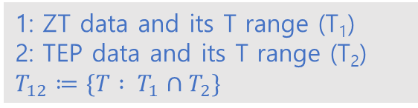
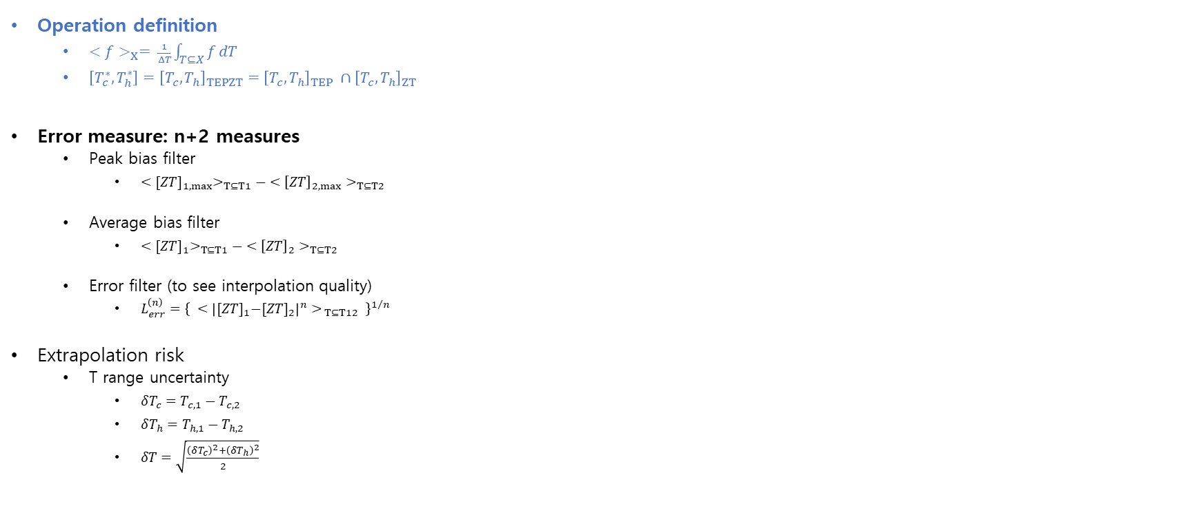
Equations for filter development
Operation definition
$<f>_{X}= \frac{1}{ΔT}\int_{T⊆X}{f}dT$
$\left[T_{c}^{∗}, T_{h}^{∗}\right]={\left[T_{c},T_{h}\right]}_{TEPZT}={\left[T_{c},T_{h}\right]}_{TEP} ∩{\left[T_{c},T_{h}\right]}_{ZT}$
Error measure: n+2 measures
Peak bias filter
$<{[ZT]}_{1,max}>_{T⊆T1}− <{\left[ZT\right]}_{2,max}>_{T⊆T2}$
Average bias filter
$<{[ZT]}_{1}>_{T⊆T1}− <{\left[ZT\right]}_{2}>_{T⊆T2}$
Error filter (to see interpolation quality)
$L_{err}^{\left(n\right)}={\left\{ <{\left|{[ZT]}_{1}−{[ZT]}_{2}\right|}^{n}>_{ T⊆T12} \right\}}^{1/n}$
Extrapolation risk
T range uncertainty
$δT_{c}=T_{c,1}−T_{c,2}$
$δT_{h}=T_{h,1}−T_{h,2}$
$δT=\sqrt{\frac{{\left(δT_{c}\right)}^{2}+{\left(δT_{h}\right)}^{2}}{2}}$
ZT and TEP data are all interpolated using piecewise-linear manner.
1: ZT data and its T range (T₁)
2: TEP data and its T range (T₂)
$T_{12}≔\{T : T_{1}∩T_{2}\}$

Slide 27
Error statistics for hi-Q

Slide 28
Error measure and table
Measure operations
Save
T range
delTc, delTh, delT
Bias measure
Peak bias
Average bias
Scatter measure
L1
L2
L3, L4
Linf
T-range record
[Tc,Th]_{TEP}
[Tc,Th]_{ZT}
[Tc,Th]TEP_{ZT}
Ten (3+2+5) error record per sample

Slide 29
Error cleansing

Slide 30
Error cleansing and classification (left) Error samples (right) cleansed & error classified
ZT error removing (>0.30)
[140 181 235 238 300 415]
+[113 235]
ZT error removing (>0.15)
[ 1 2 26 27 28 79 81 92 95 98 110 113 124 125 129 139 140 151 152 165 181 193 210 220 235 238 245 254 285 293 300 355 381 409 415]
+[ 1 2 26 79 81 84 95 107 113 129 181 193 235 238 293 415]
Digitization error, Cleansed: Axis error
1 (sigma y axis digitization error corrected),
28, 253, 355 (poor resolution 재추출 후, error reduced)
notError
5, 156, 420 (T range mismatch, but data is ok)
Lack of data, cannot reproduce
235 (k_el in k_tot, deleted)
ZT error (biased, publication error)
26, 95, 125, 415 (checked, over ZT)
81 (checked, under ZT)
Extrapolation
84, 107, 113 (TEP fitted and ZT made?)
Interpolation cannot reproduce
27, 300, 409 (sigma phase transition, resolution, cannot interpolate)
teMatDb excel file 과 redigitizing (문헌다시비교)
에러로그 기록(작성중) ➔ error_cleansing_log.xlsx

Slide 31
Cleansed, corrected, notError

Slide 32
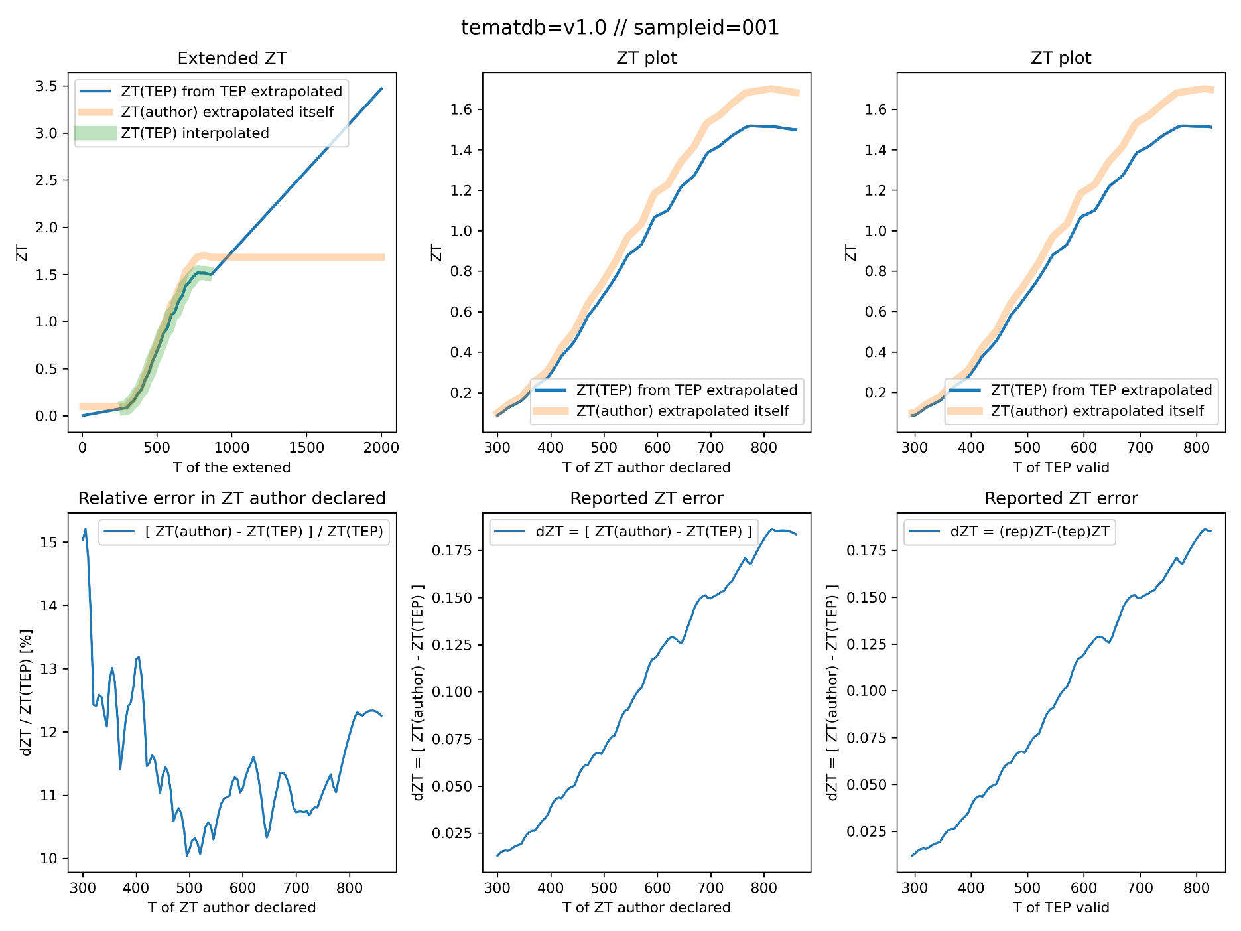
Sampleid = 1
Corrected, now no error
Literature
10.1038/NCHEM.955
Biswas, Kanatzidis, Nature Chem
ZT over reported
ZT author declared: 1.7
ZT reevalulated from TEP: 1.5
Possible error origin
Poor resolution
ZT over declared

Slide 33
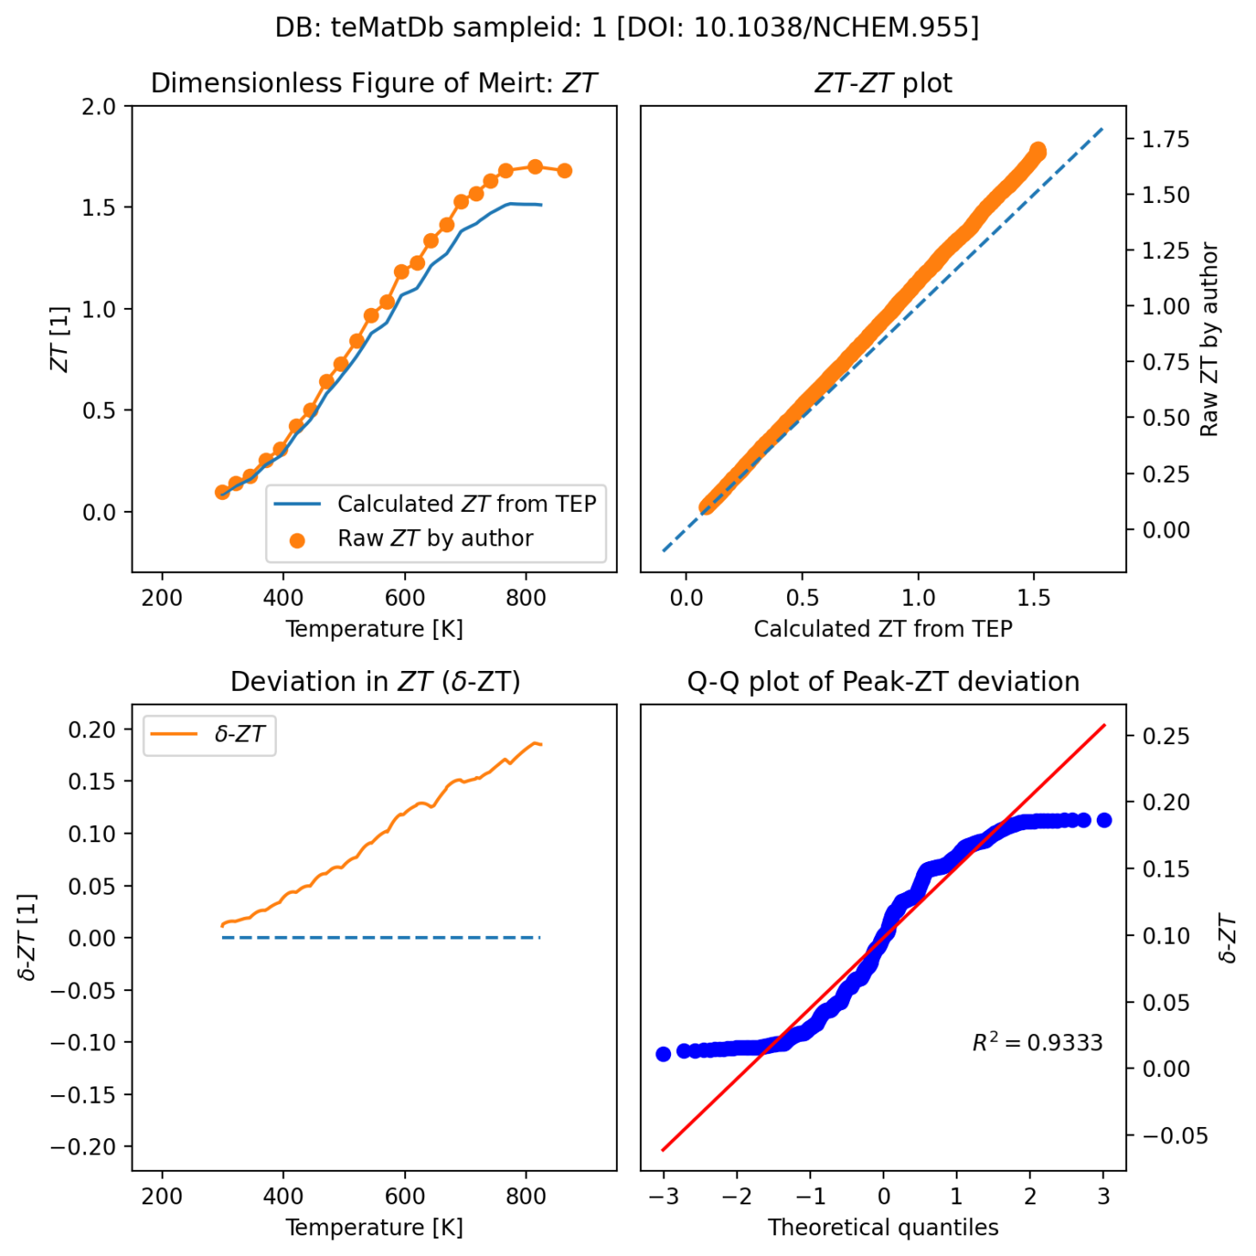
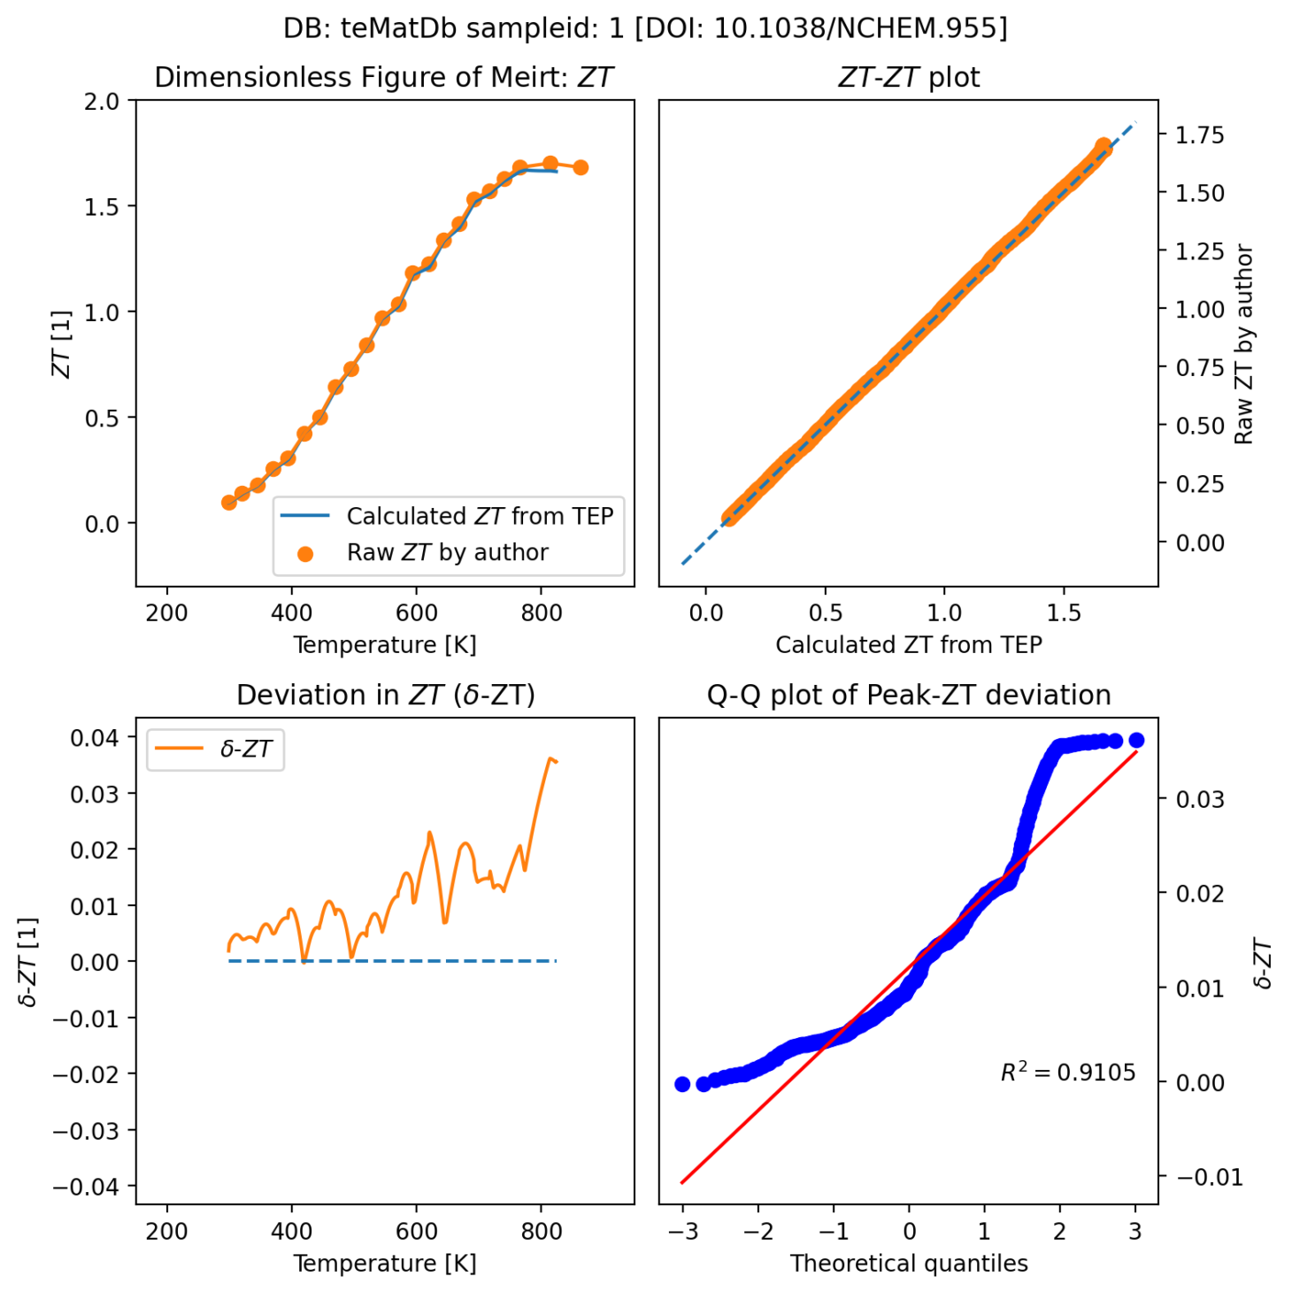
Sampleid=1 (재추출) digitization error: sigma y2 axis corrected
before
after
https://tematdb-v1-0-0-main-v1-0-2-abc.streamlit.app/
v1.1

Slide 34
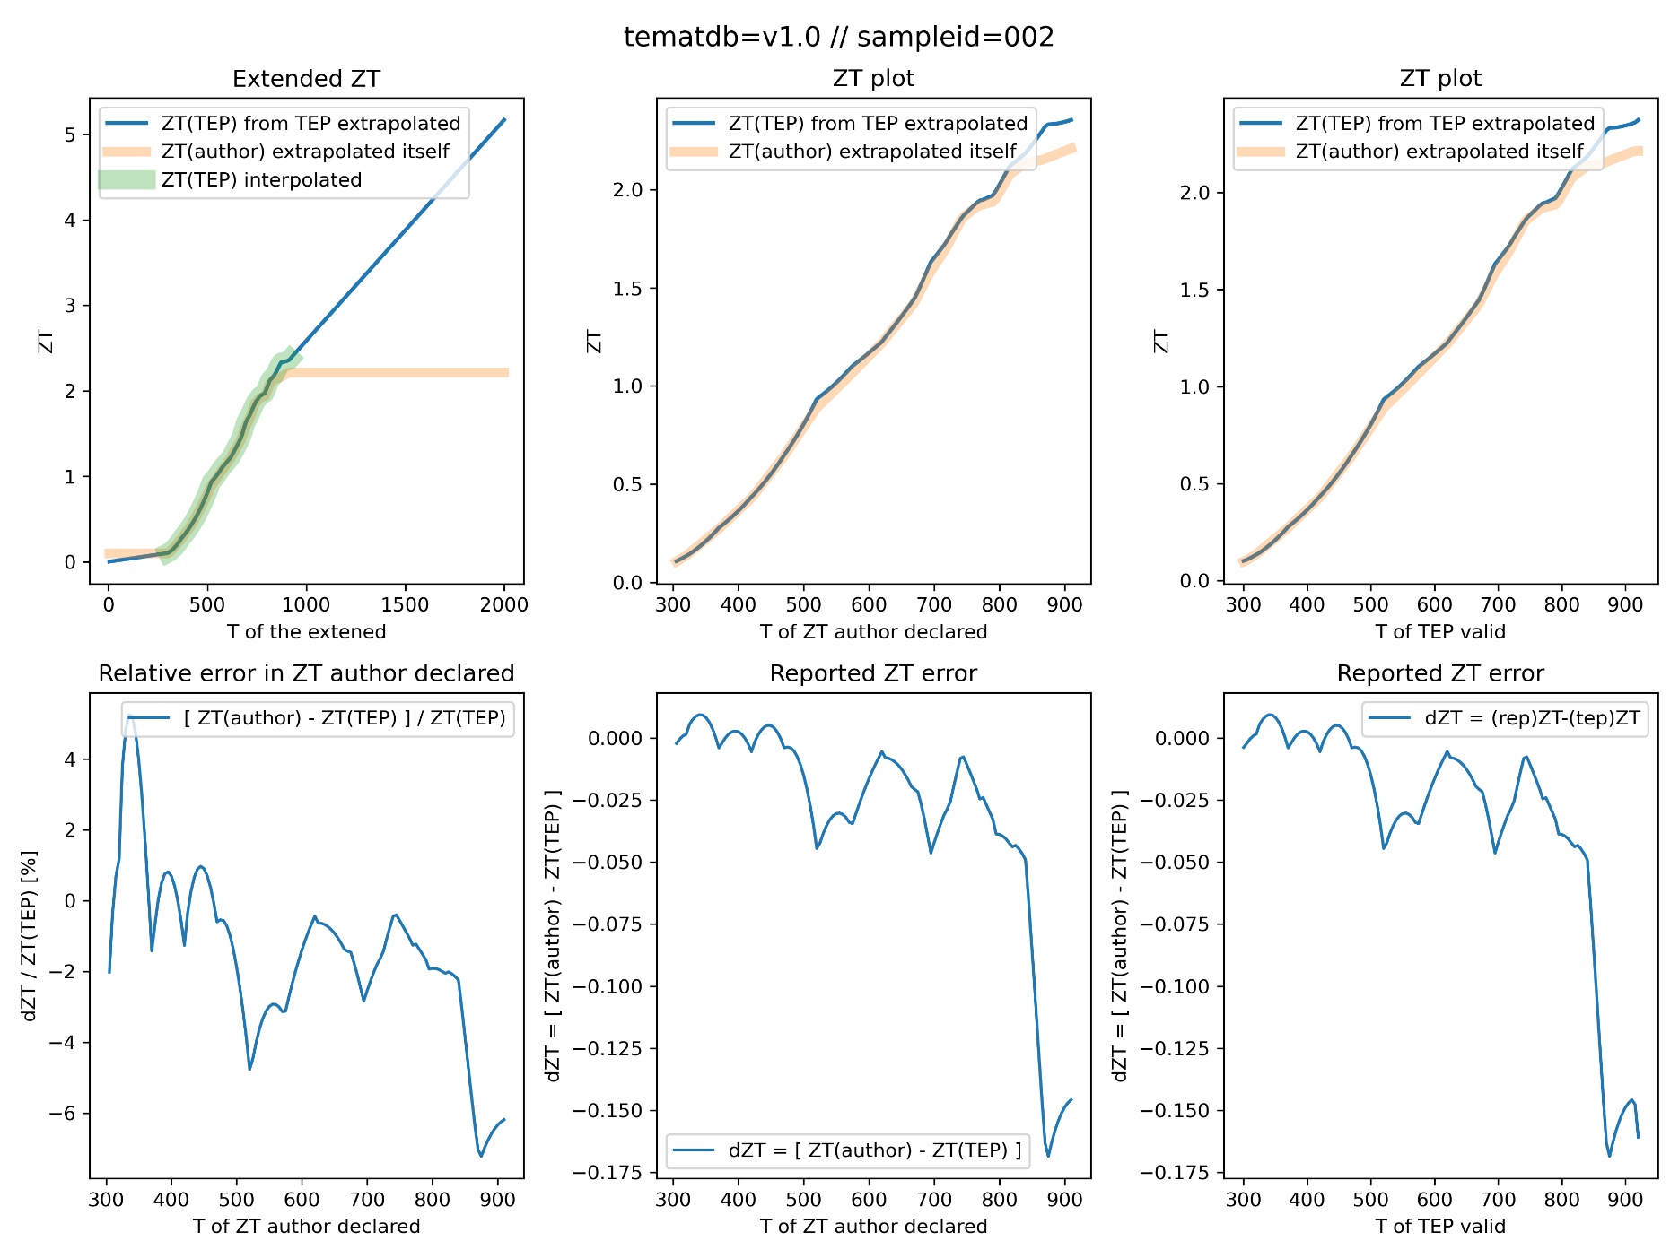
Sampleid = 2
Corrected, now no error
Literature
10.1038/nature11439
Biswas, Kanatzidis, Nature
ZT over reported
ZT author declared: 2.2
ZT reevalulated from TEP: 1.5
Possible error origin
Extrapolation
ZT under declared

Slide 35
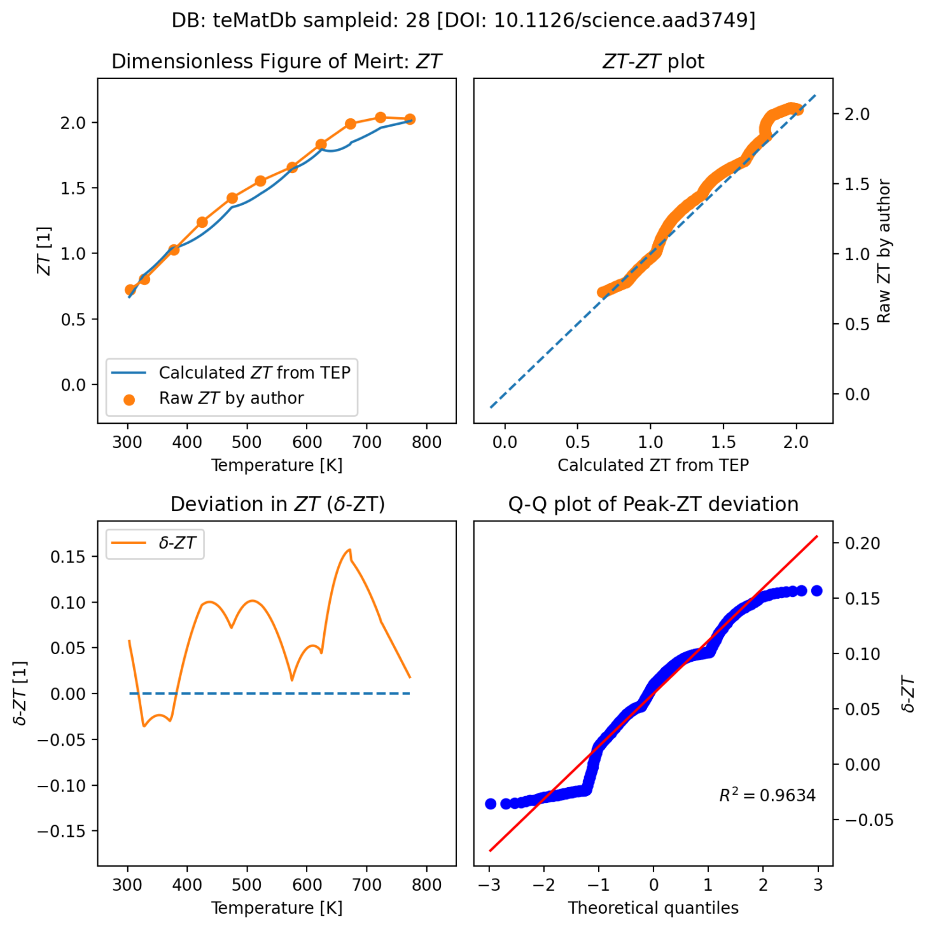
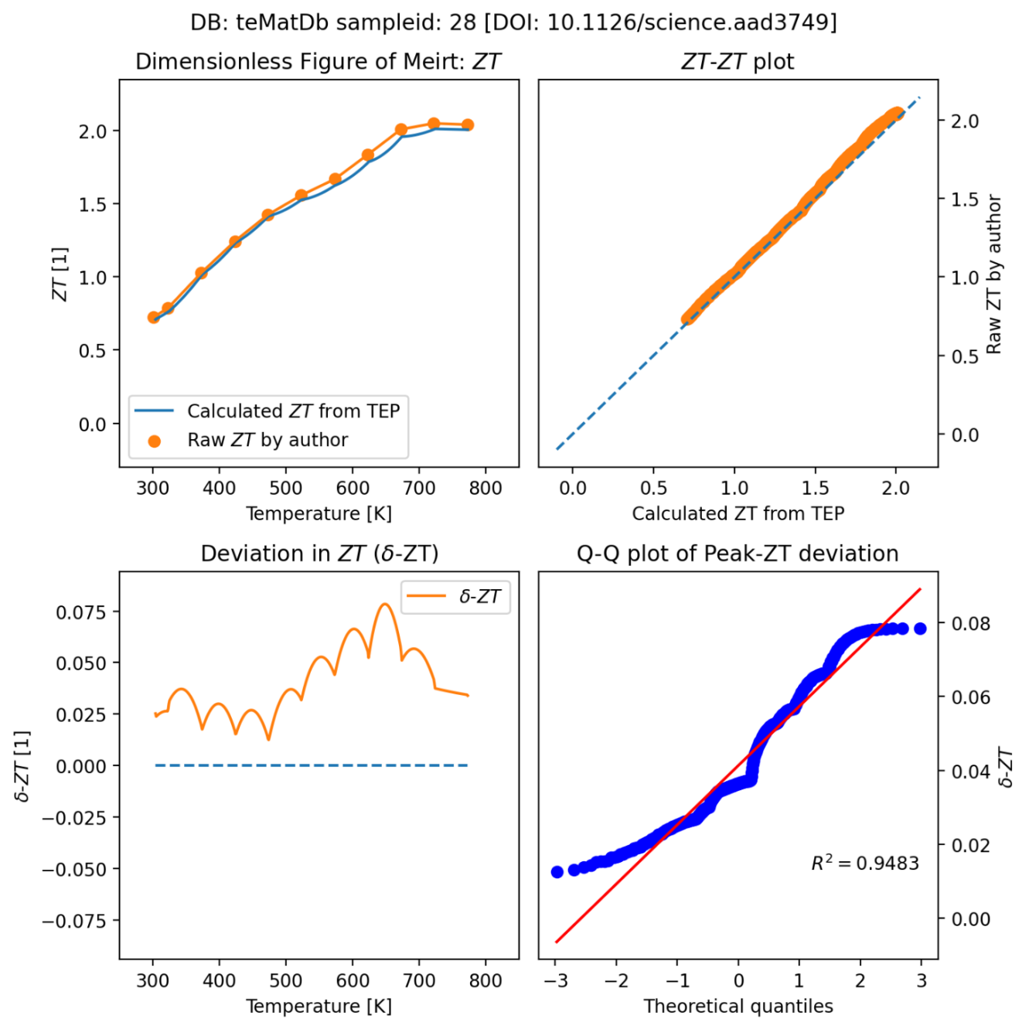
Sampleid=28 (재추출) poor resolution, but overcome
before
after
https://tematdb-v1-0-0-main-v1-0-2-abc.streamlit.app/
v1.1

Slide 36
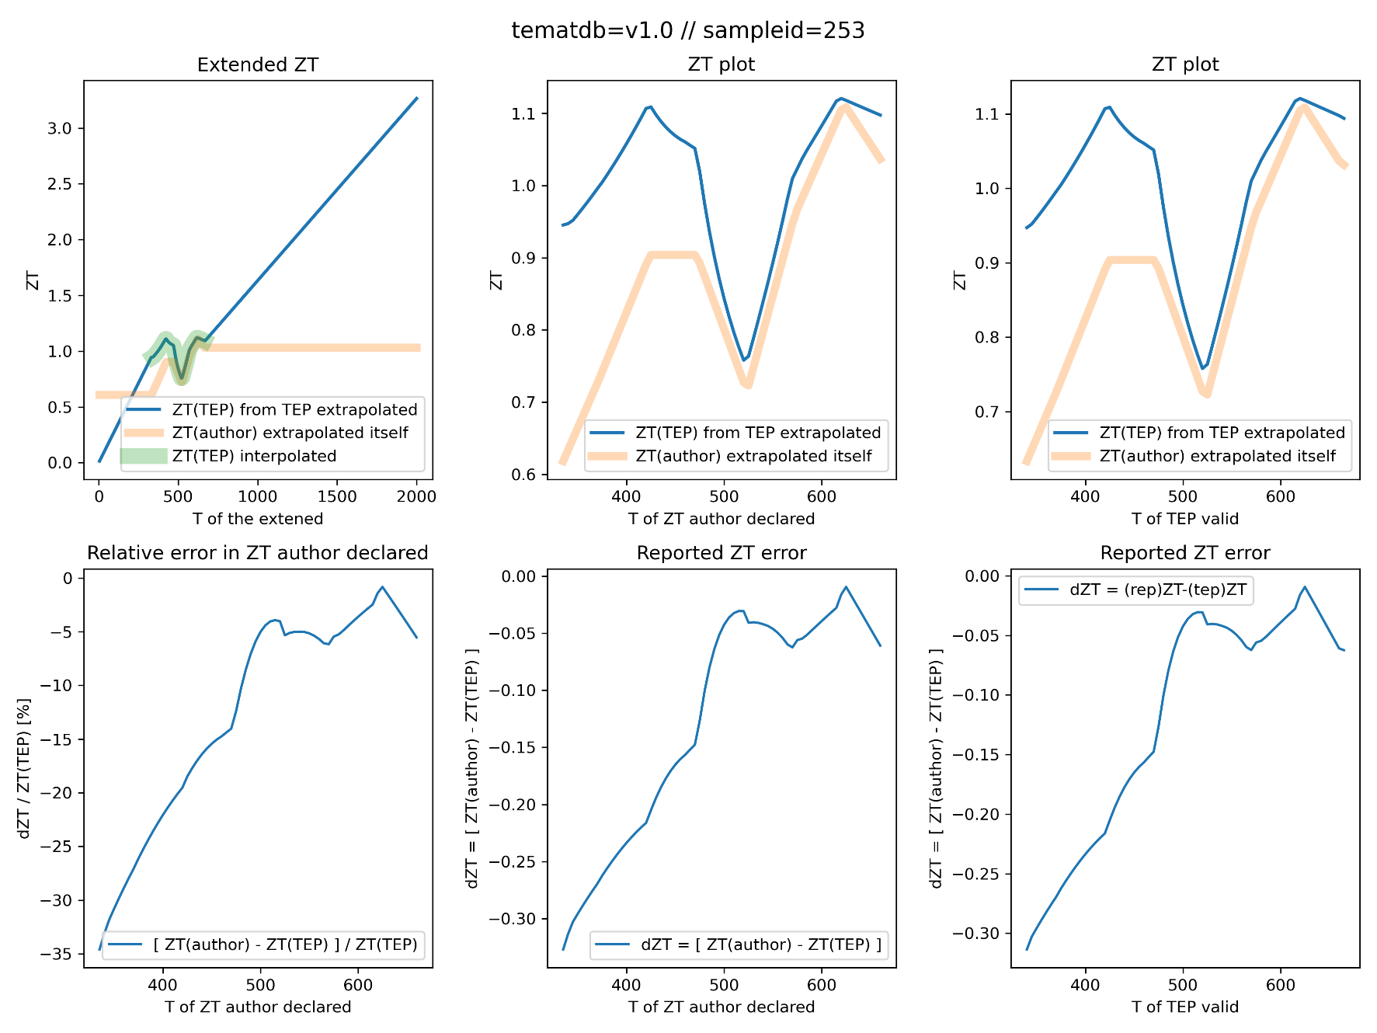
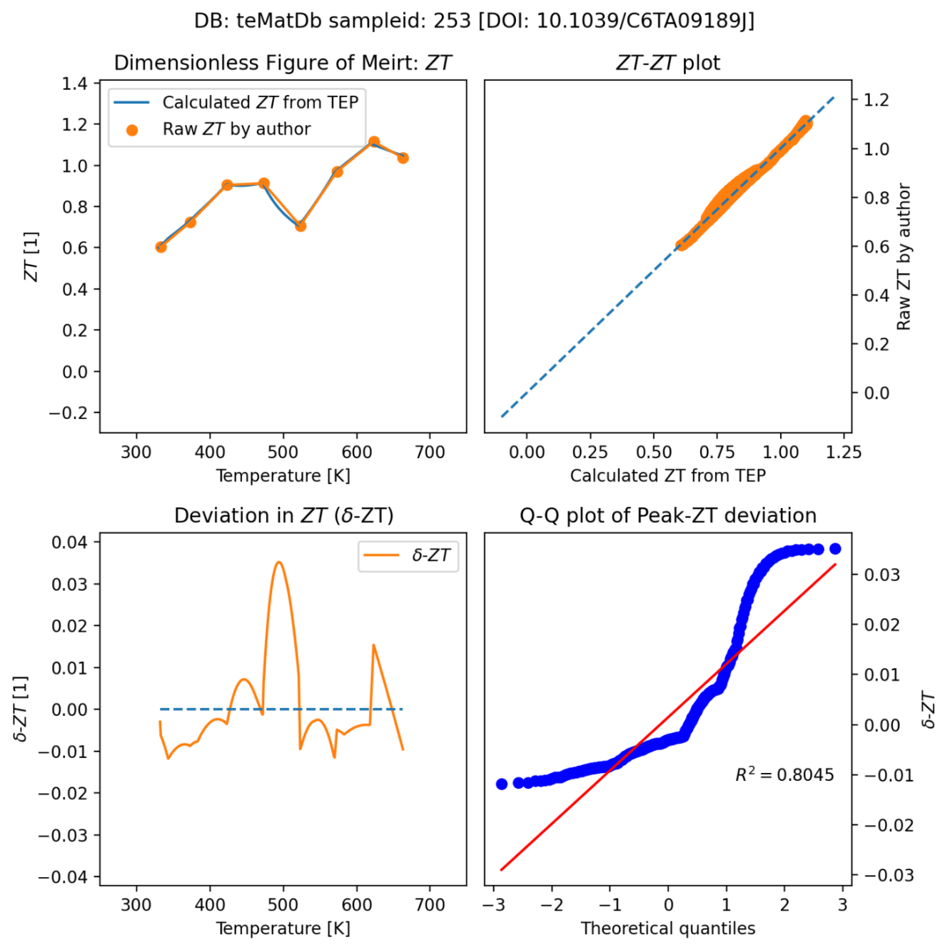
Sampleid = 253 // teMatDb error, updated
Keri error, wrong sample
updated

Slide 37
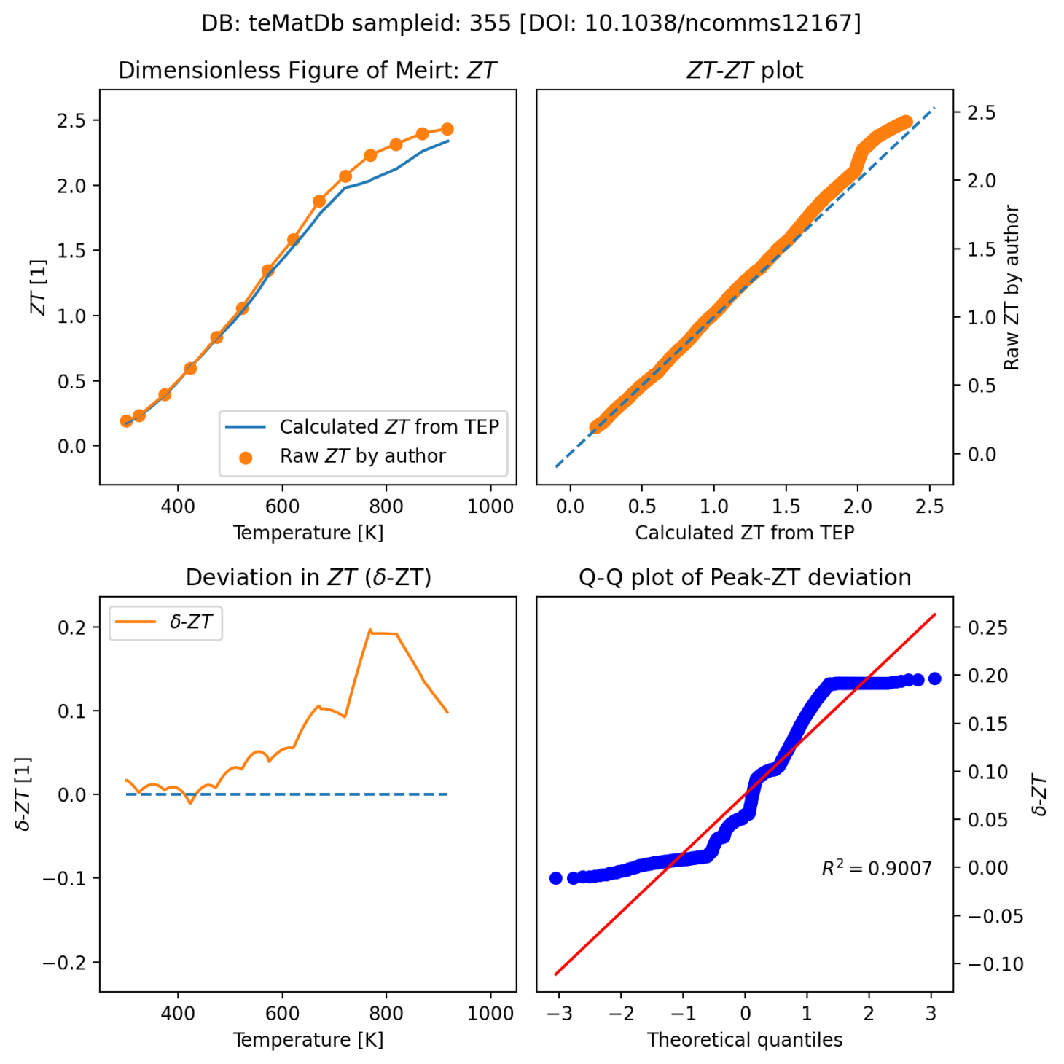
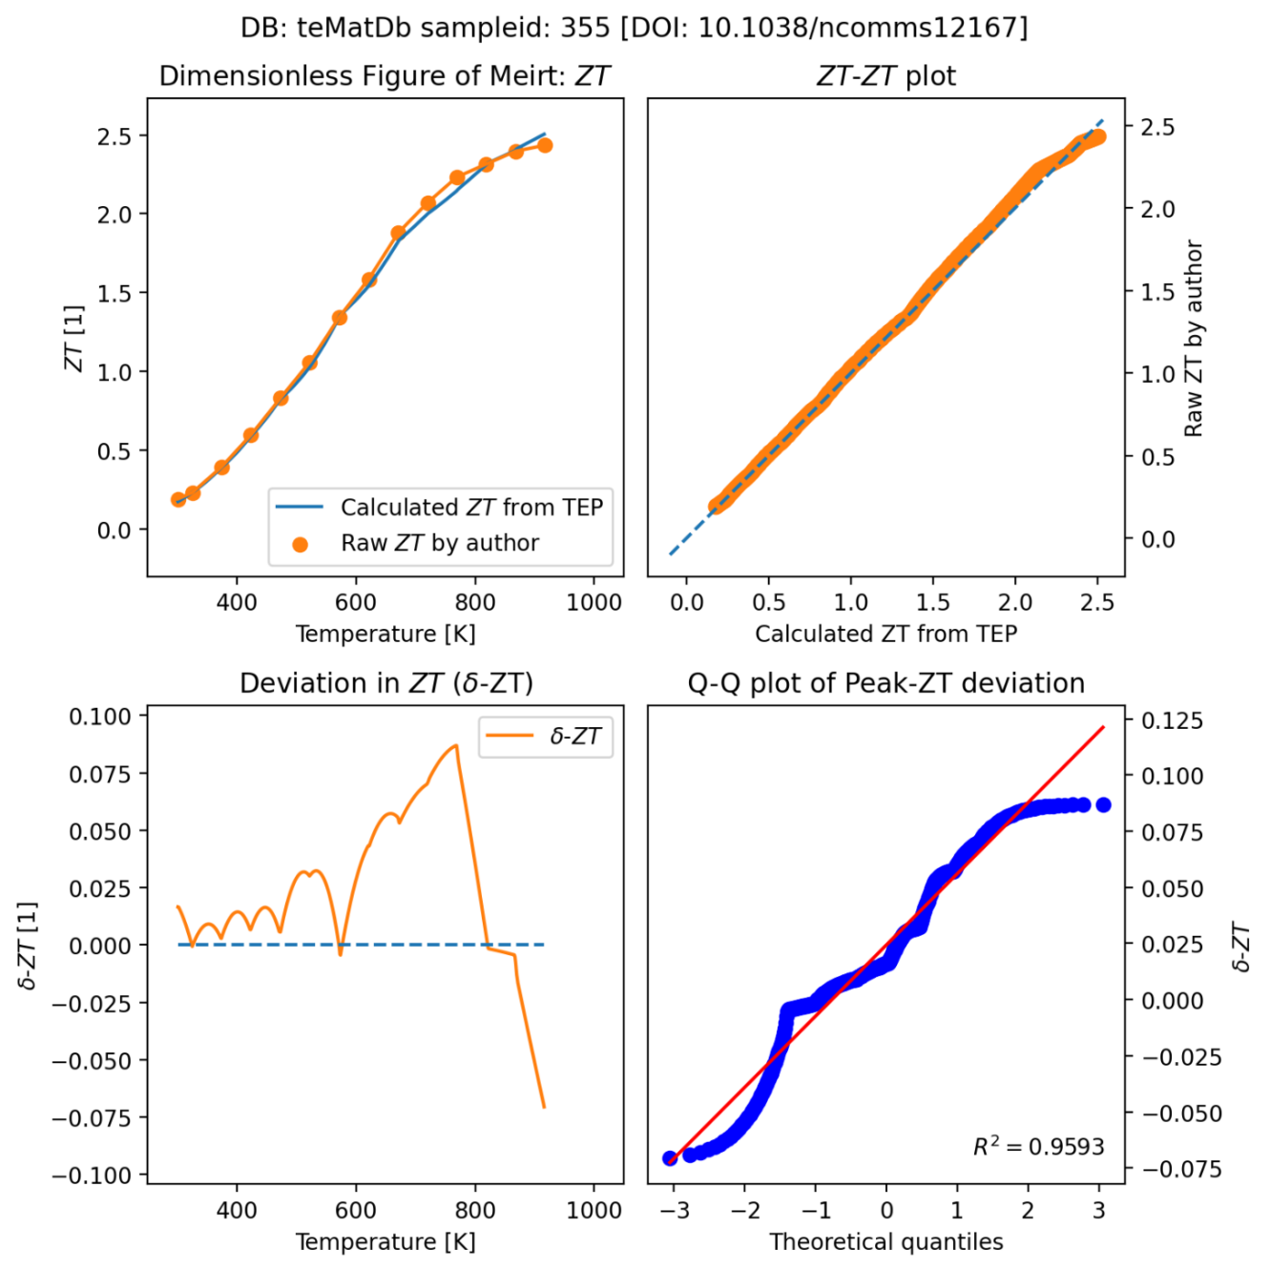
Sampleid=355 (재추출) poor resolution, but overcome
before
after
https://tematdb-v1-0-0-main-v1-0-2-abc.streamlit.app/
v1.1

Slide 38
T range mismatch, not error

Slide 39
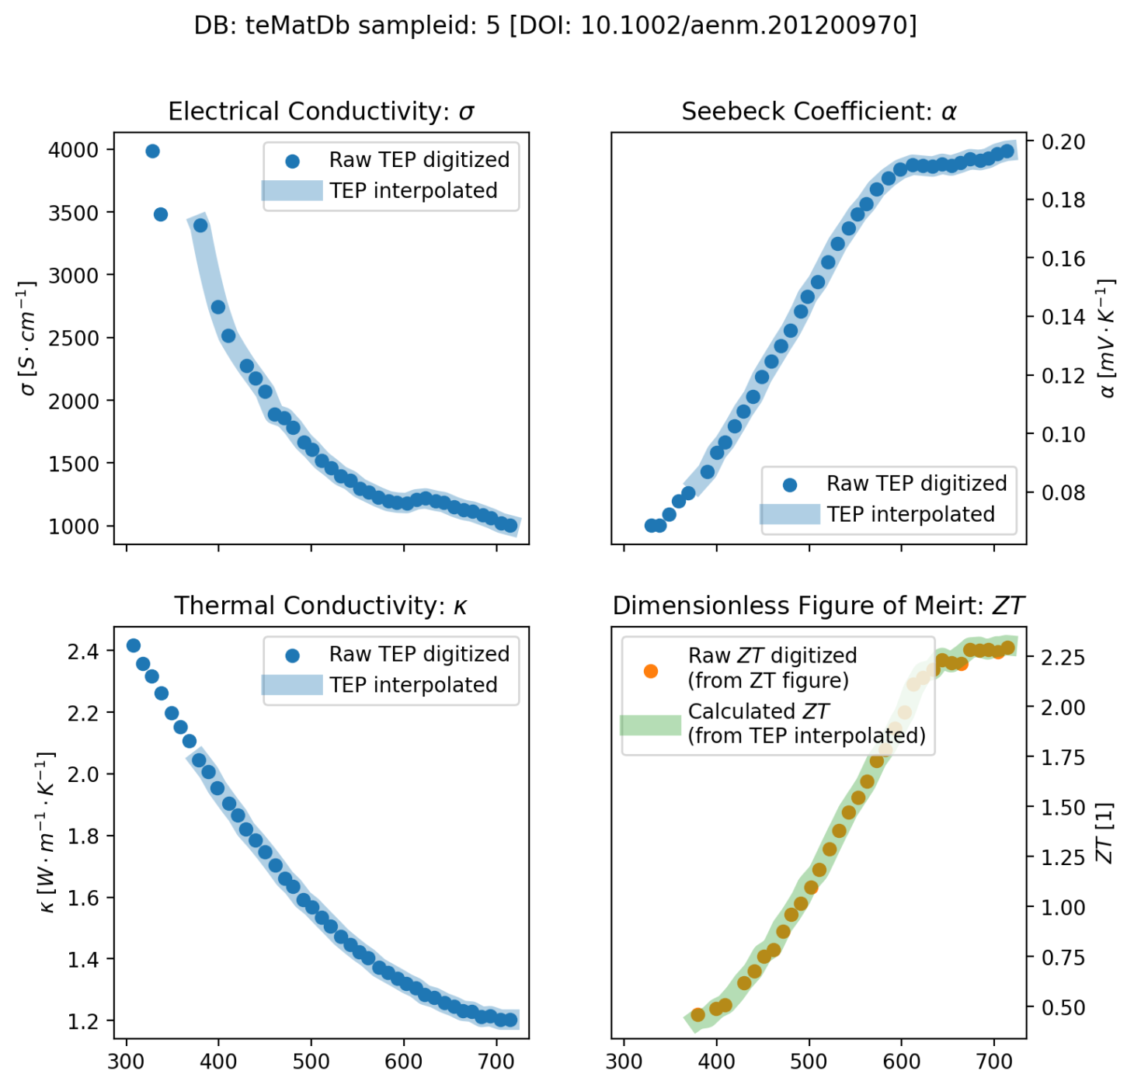
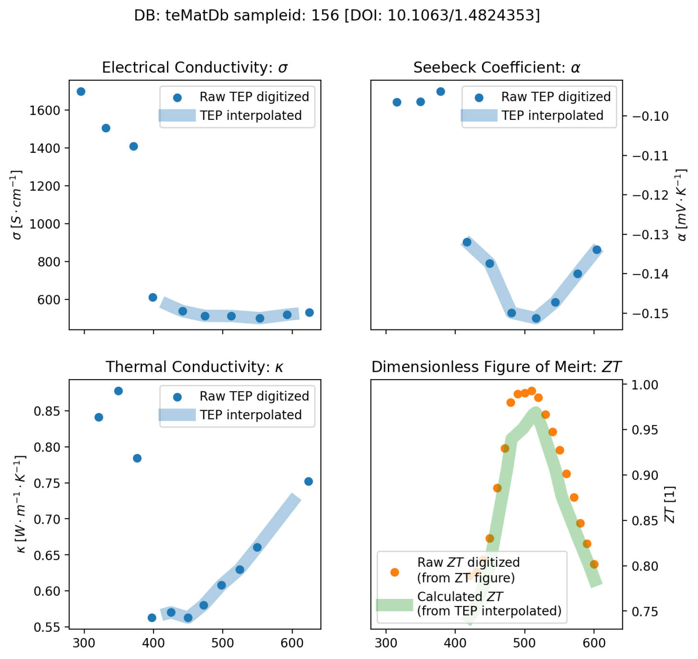
Sampleid=5, 156, ZT range small, avg ZT mismatch, but not error
Avg ZT on T of TEP != avg ZT on T of ZT.
T of TEP != T of ZT

Slide 40
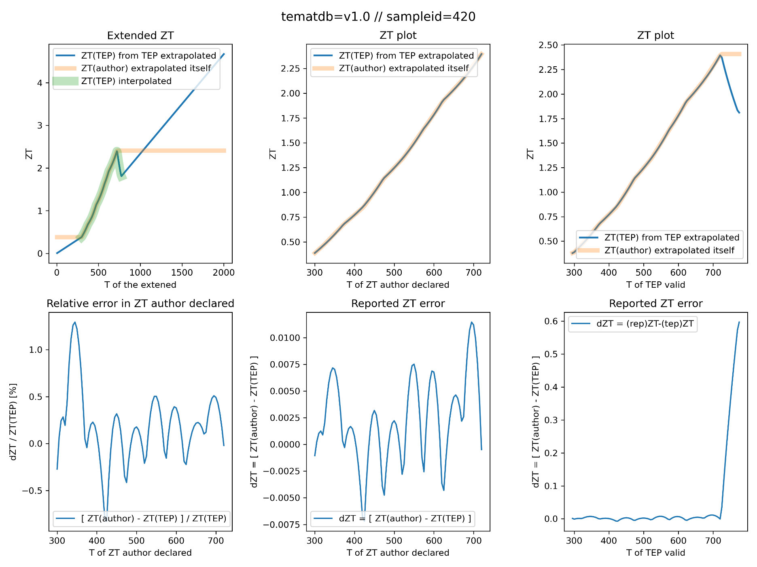
Sampleid = 420 (not error)
T range difference
ZT T range smaller than TEP T range
As ZT is extrapolated to TEP T range, it is inconsistent to TEP ZT.

Slide 41
Extrapolation, high ZT error

Slide 42
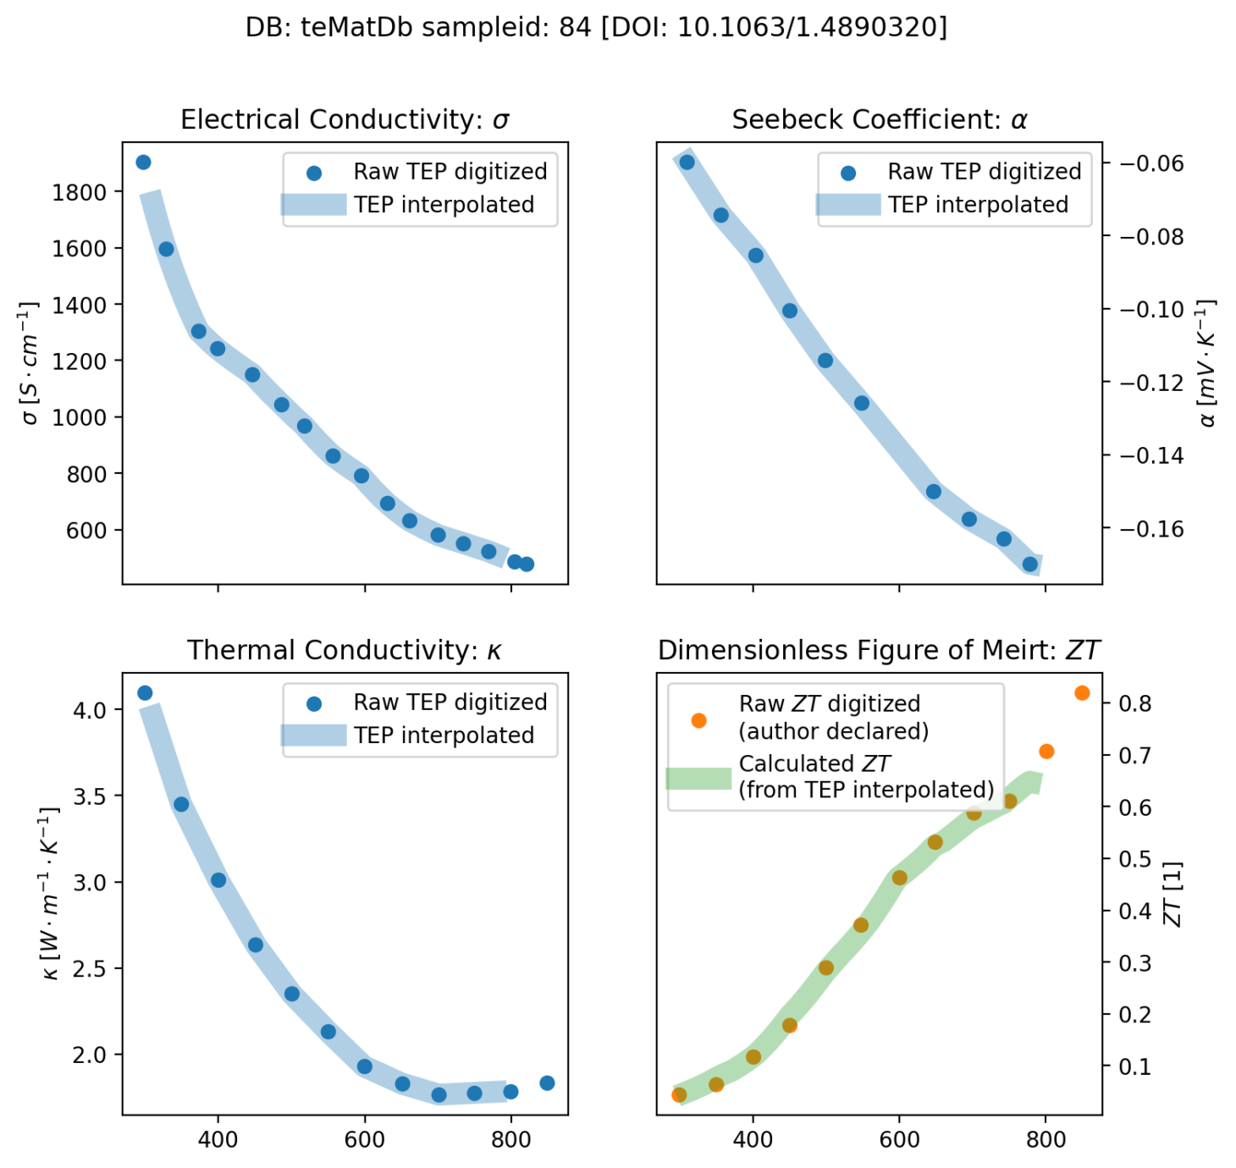
Sampleid=84 (extrapolation)
No high-T seebeck

Slide 43
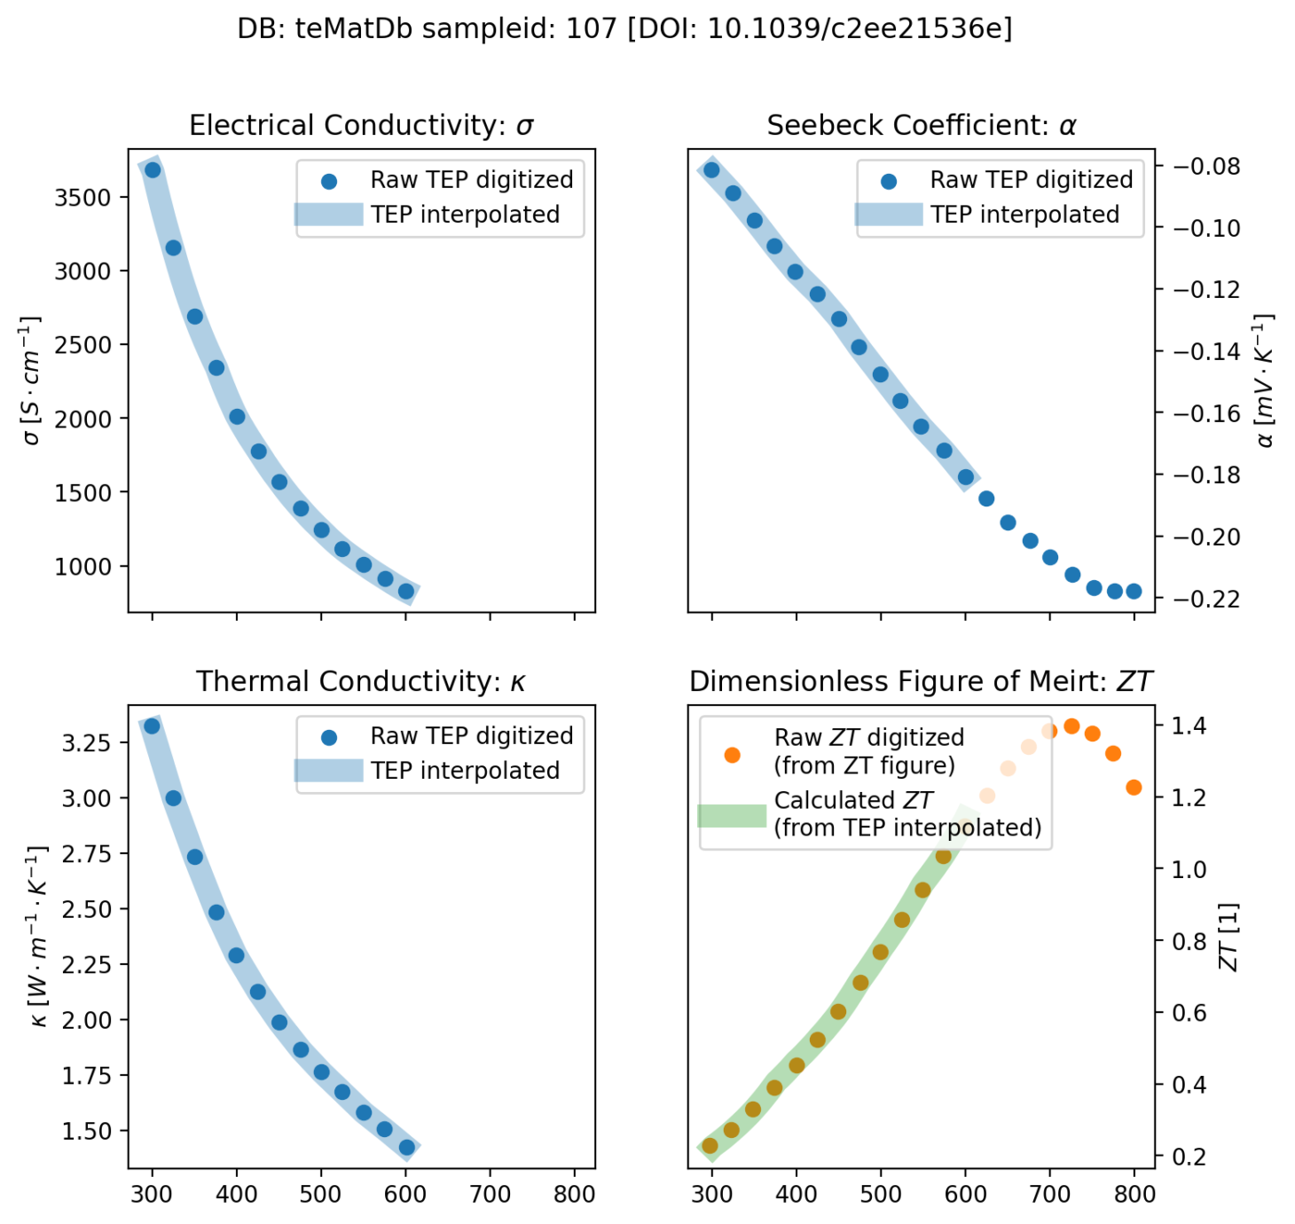
Sampleid = 113, TEPs are extrapolated
ZT can not be reproduced from measured TEPs

Slide 44
Sampleid = 113, TEPs are extrapolated
Largely extrapolated value
ZT author declared: 1.47
ZT reevaluated from tep: 1.15

Slide 45
Biased (can not reproduce, even after redigitizing)

Slide 46
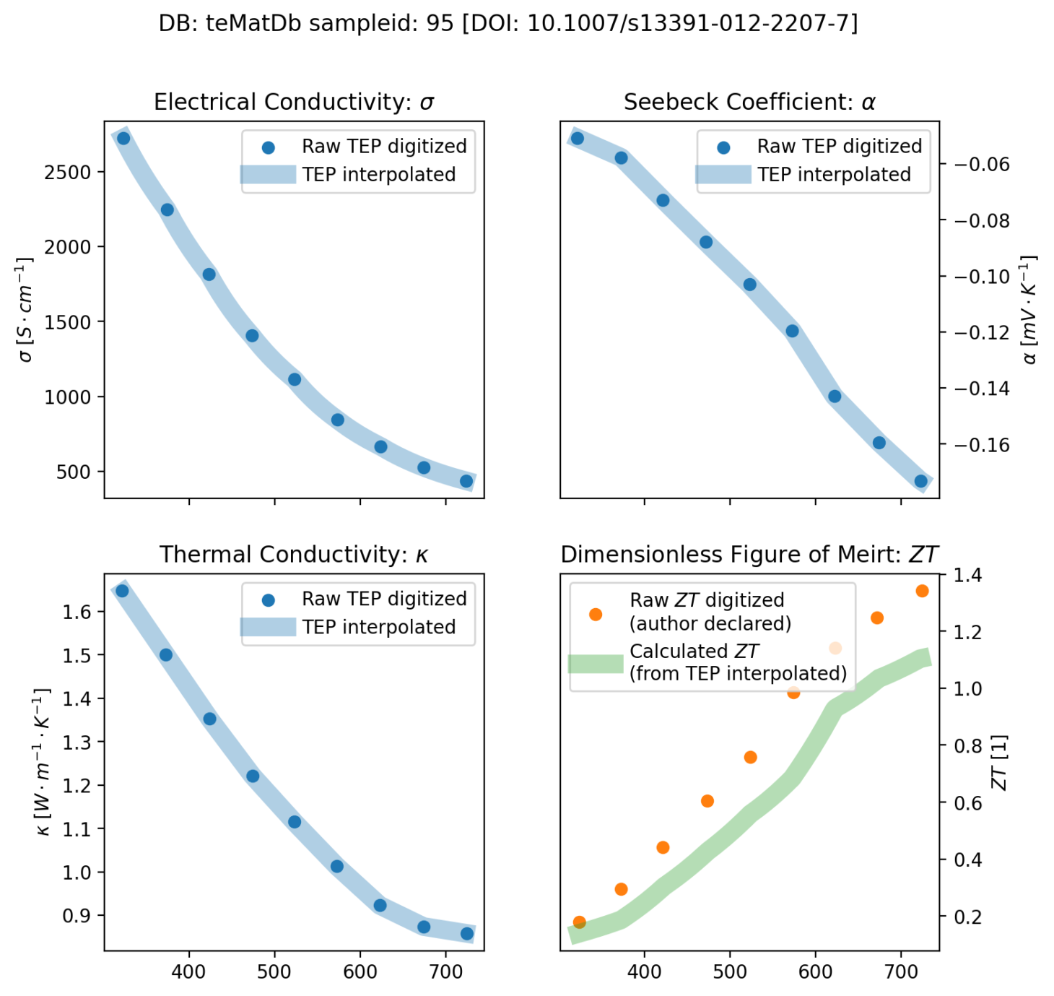
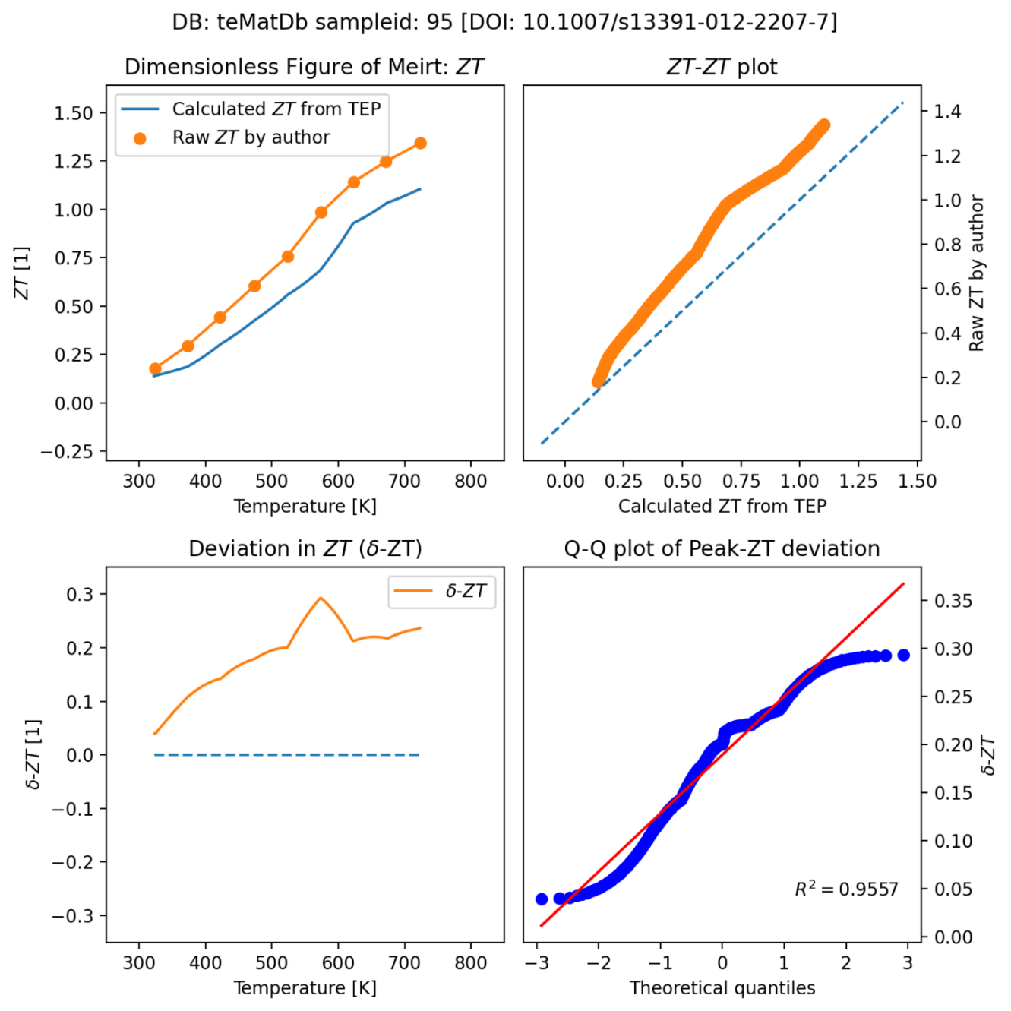
Sampleid=95 (publication error)

Slide 47
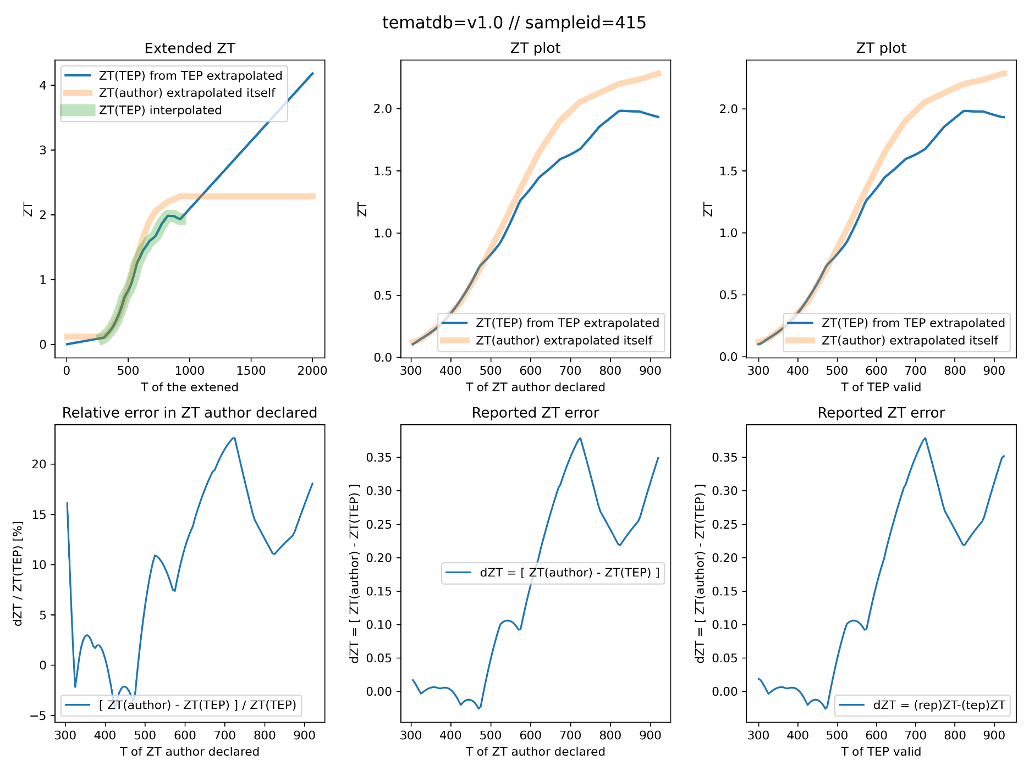
Sampleid = 415
Literature
10.1002/aenm.201601450
LD Zhoa, Adv E Mater
ZT over reported
ZT author declared: 2.3
ZT reevalulated from TEP: <2.0
Possible error origin
Error from mismatch between PF and conduction

Slide 48
Lack of data

Slide 49
Sampleid = 235, K_elec is missing
Difficult to get a dataset
No k_tot figure, though k_elec equation is given
k_elec = L sigma T (Lorenz-Wiederman Law, L = 2x10^-8)
k_latt = k_tot – k_ele
Inconsistent notation for compositions

Slide 50
APPENDIX.1. Error cases

Slide 51
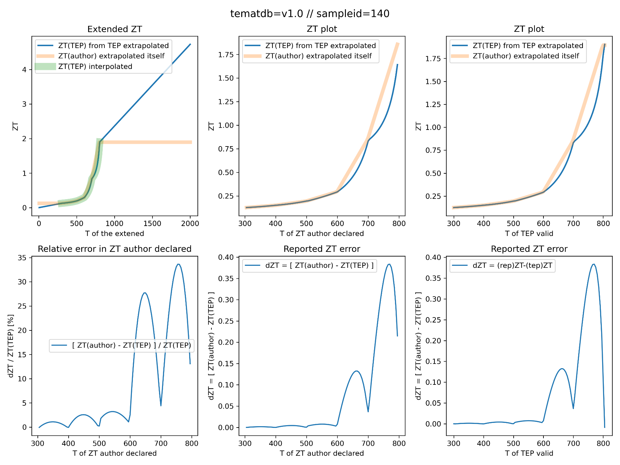
Sampleid = 140, computation
T range of TEP is smaller than T range of ZT
Mismatch from extrapolation

Slide 52
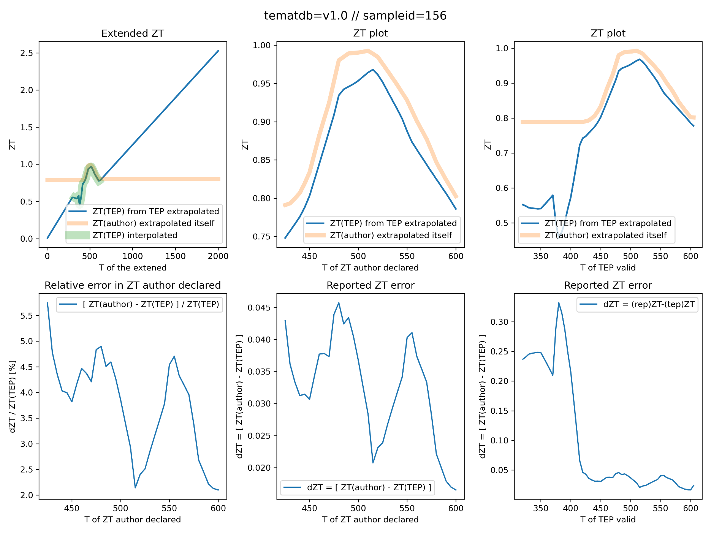
Sampleid = 156
T range of TEP is smaller than T range of ZT
Mismatch from extrapolation

Slide 53
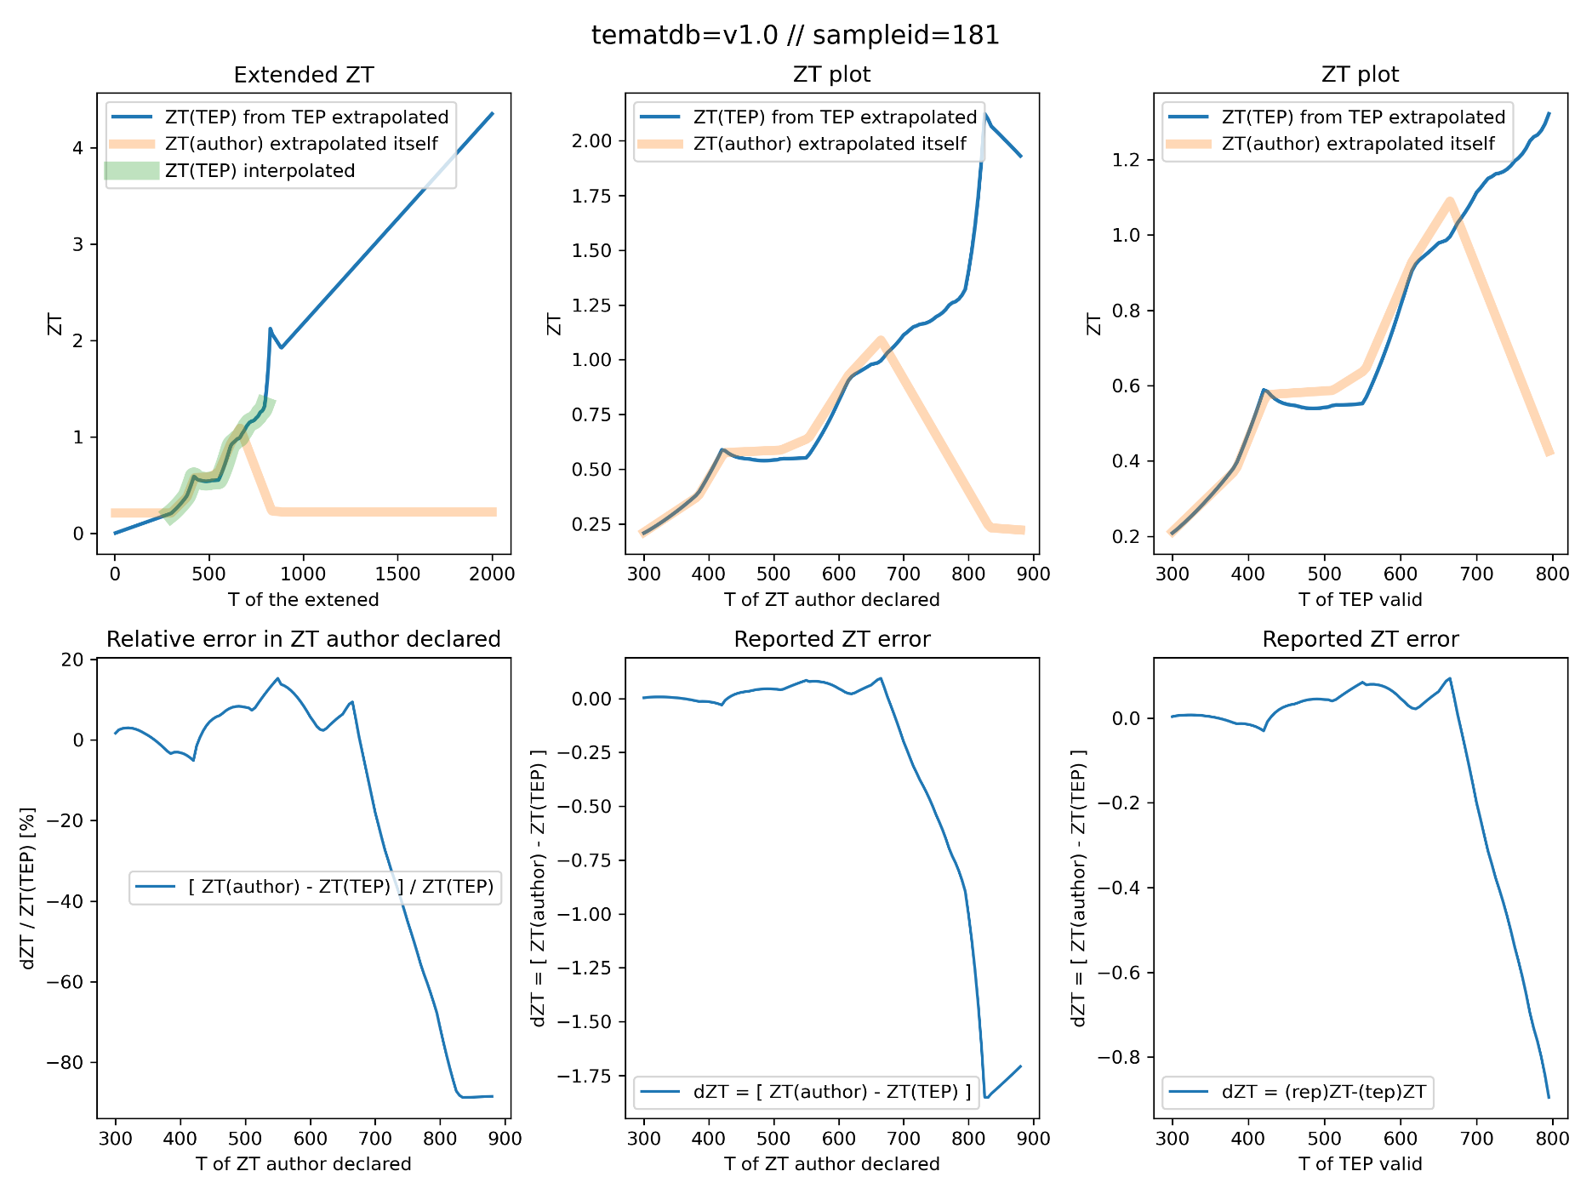
Sampleid = 181 // exponential or extrapolation or publication error

Slide 54
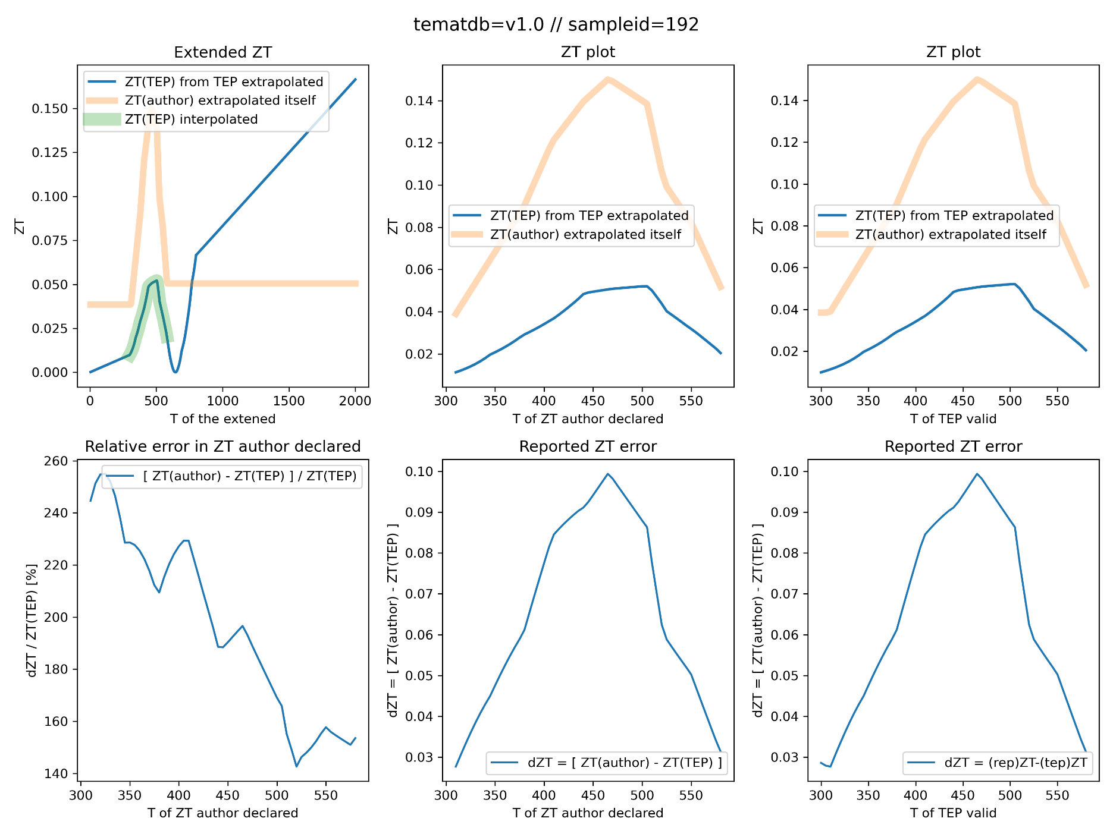
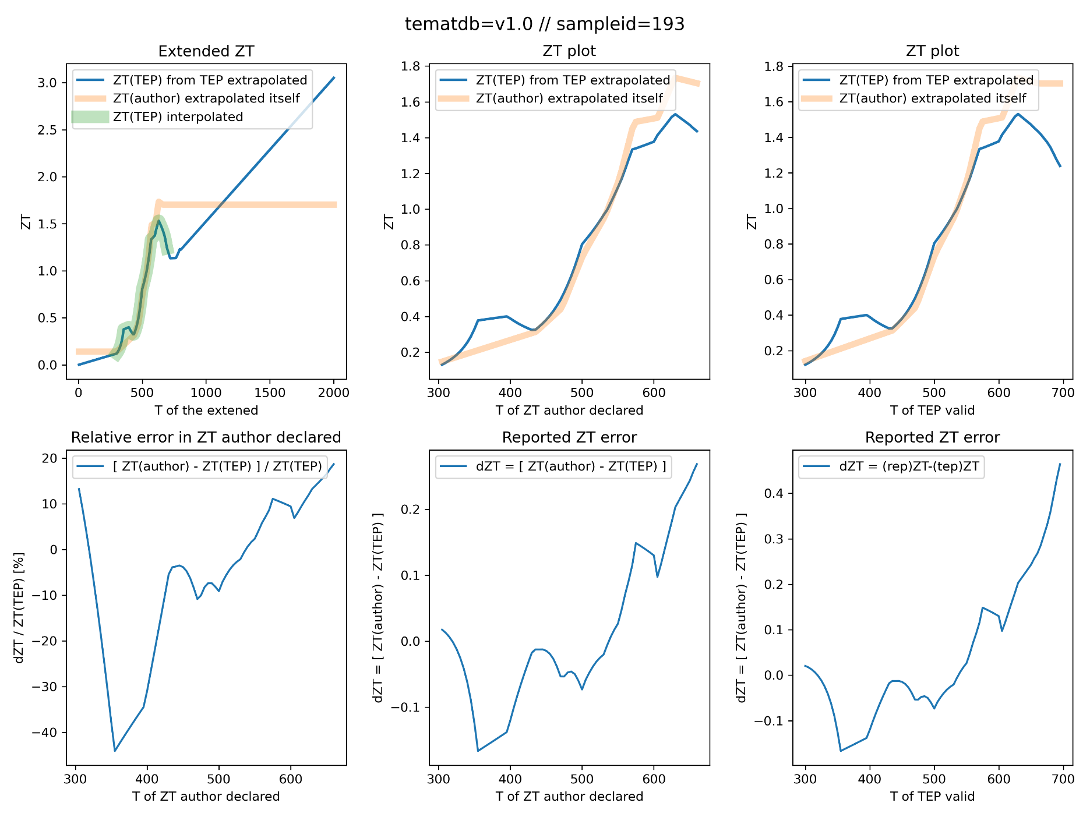
Sampleid = 192, 193 (doi=10.2320/matertrans1989.33.851)

Slide 55
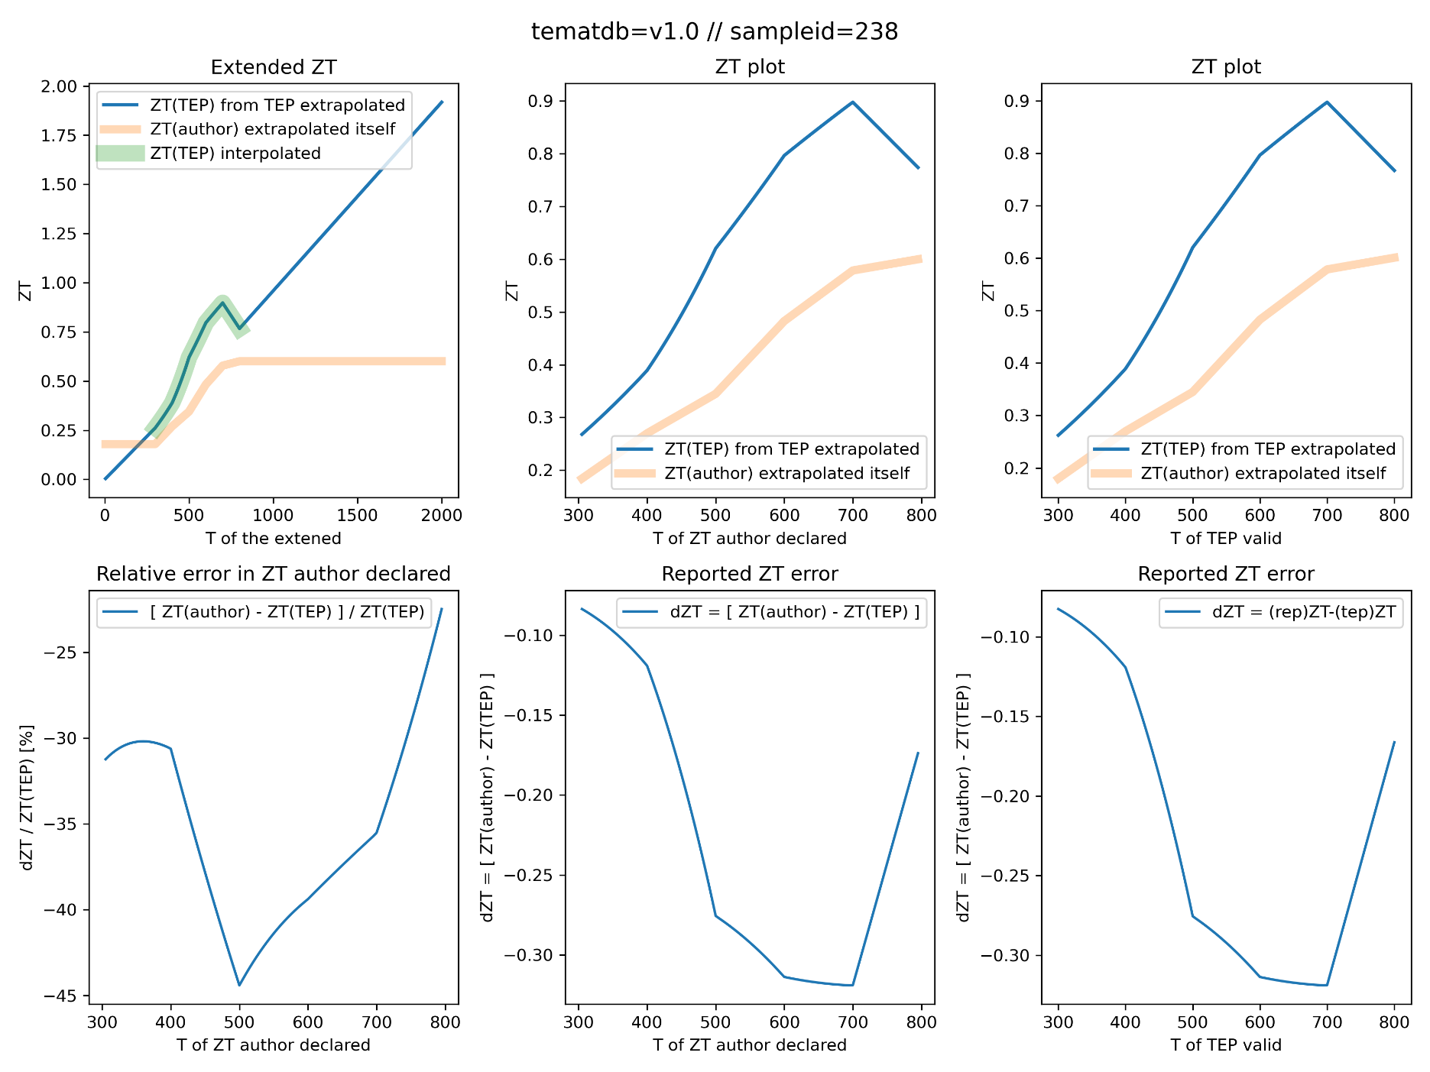
Sampleid = 238
Check several times
Check exchange persons
But problem remained
Might be publication error

Slide 56
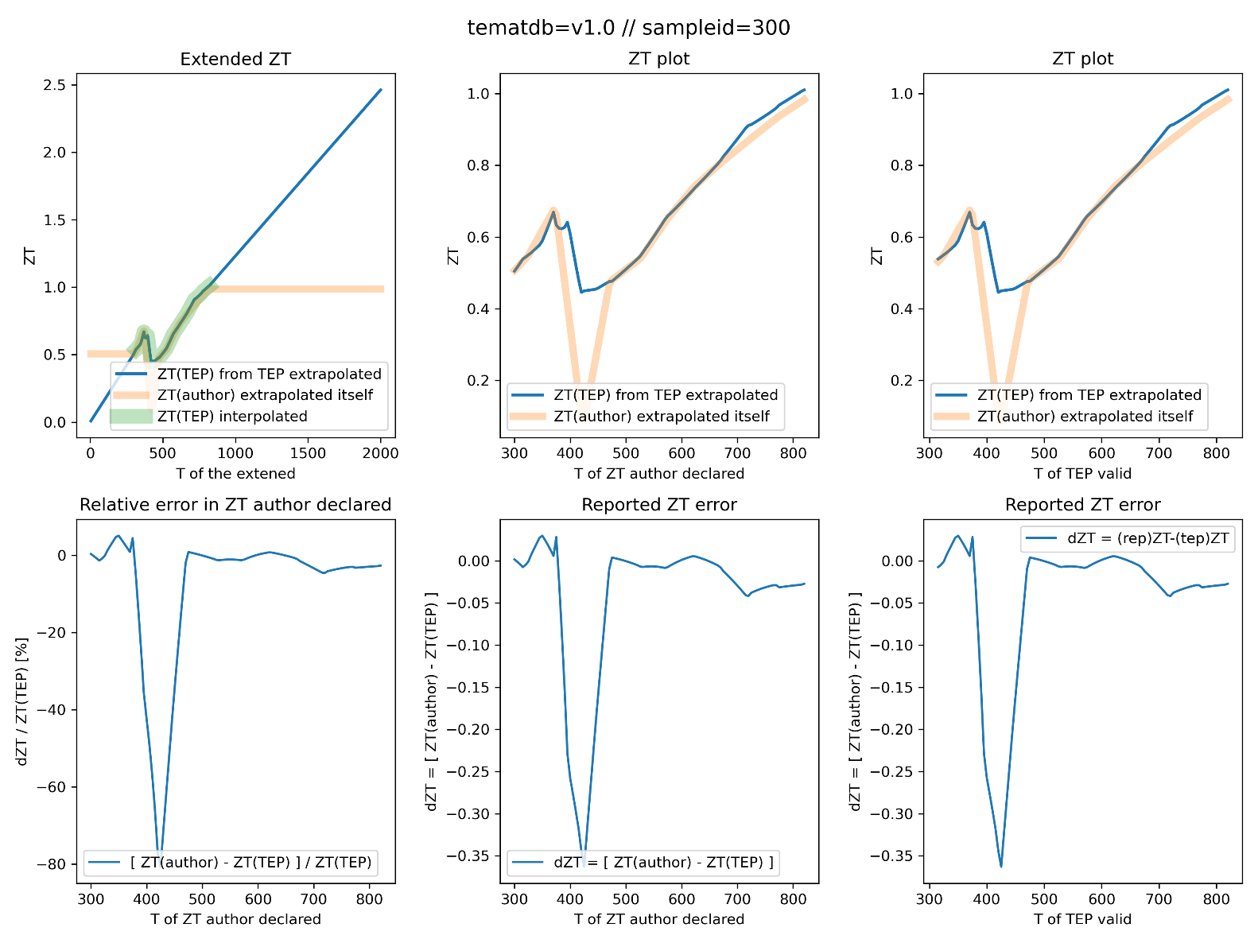
Sampleid = 300
Rapidly varying TEP curves, difficult to interpolate
Reevalutation overestimate ZT owing to poor interpolation by us

